Slide 1




Visualisation in
Sam Keat
PhD Student - UK Dementia Research Institute, Cardiff
KeatS@cardiff.ac.uk

Slide 2
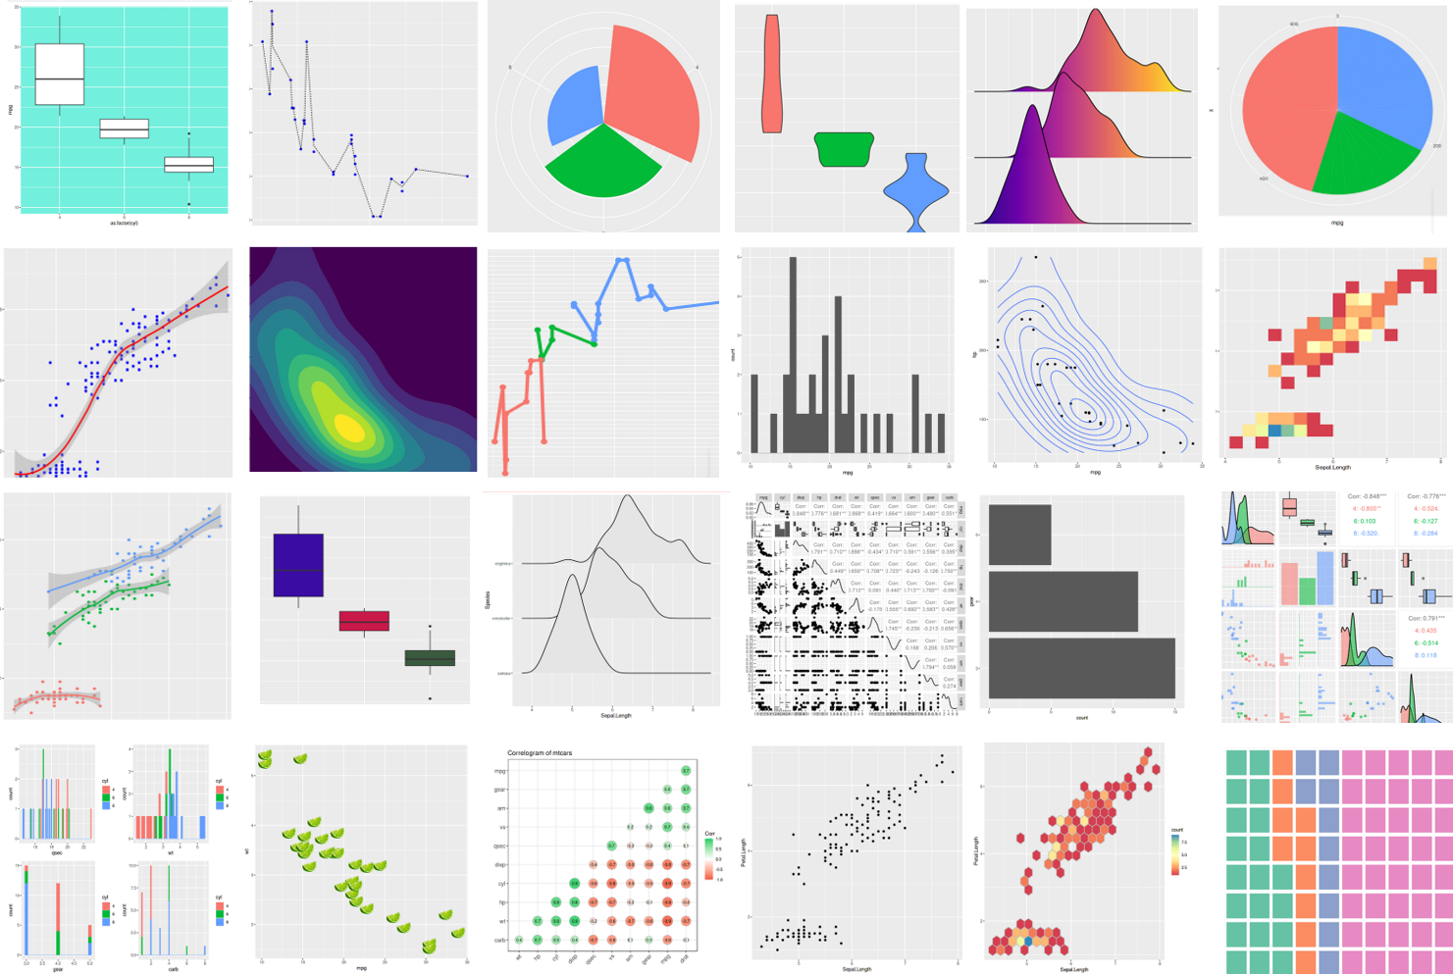
Visualisation
Making your data come to life!

Slide 3
Objectives
How data can be visualised in R
Learn how to adjust graphics
Get familiar with ggplot2 and it’s grammar of graphics to create amazing figures

Slide 4
Data Visualisation - An Overview
The overall aim of visualising data:
Make all your plots as self explanatory as possible!
For these lectures, we will focus on ggplot2, a tidyverse package and one of the most useful visualisation tools for a bioinformatician
Versatile, powerful and easy to use (once you learn the graphics grammar) package
Has multiple add-ons, such as ggrepel (for text labels) and ggpubr (for publication-ready plots) or patchwork (for combining multiple plots)

Slide 5
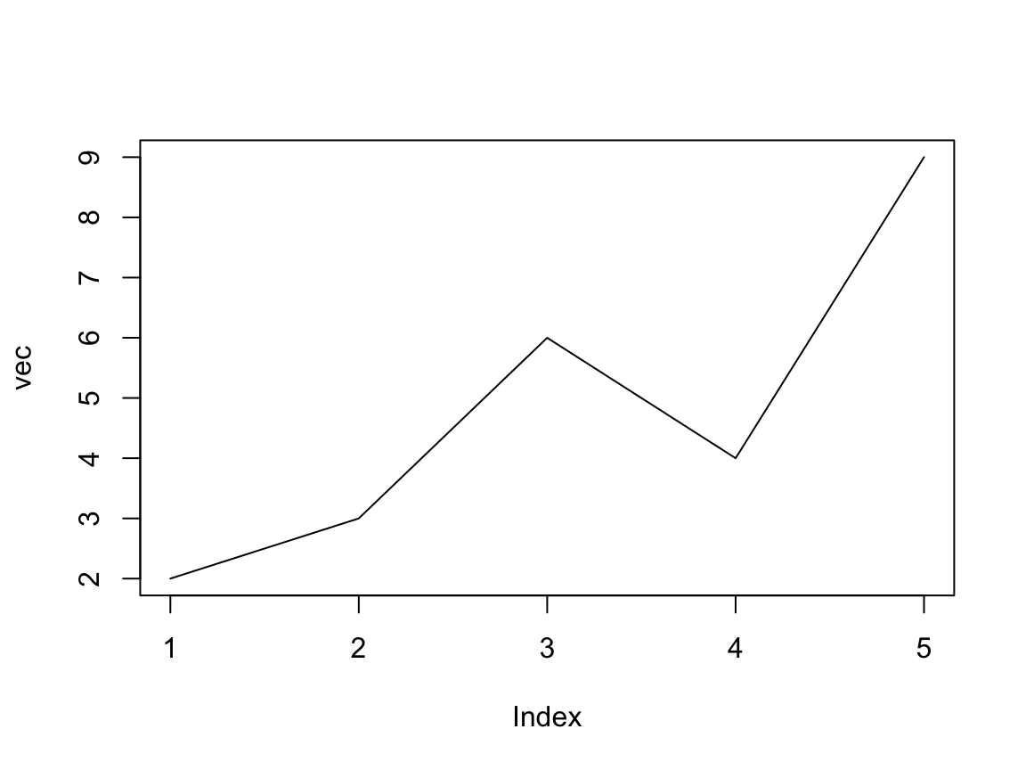
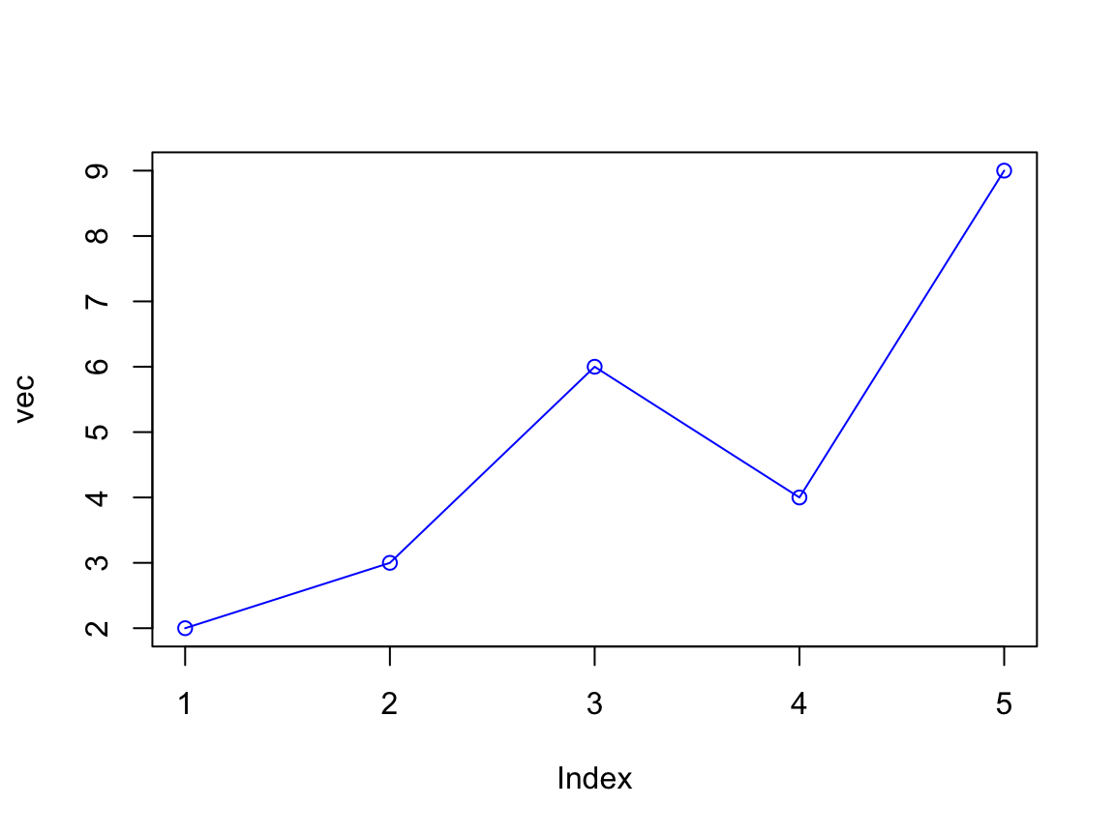
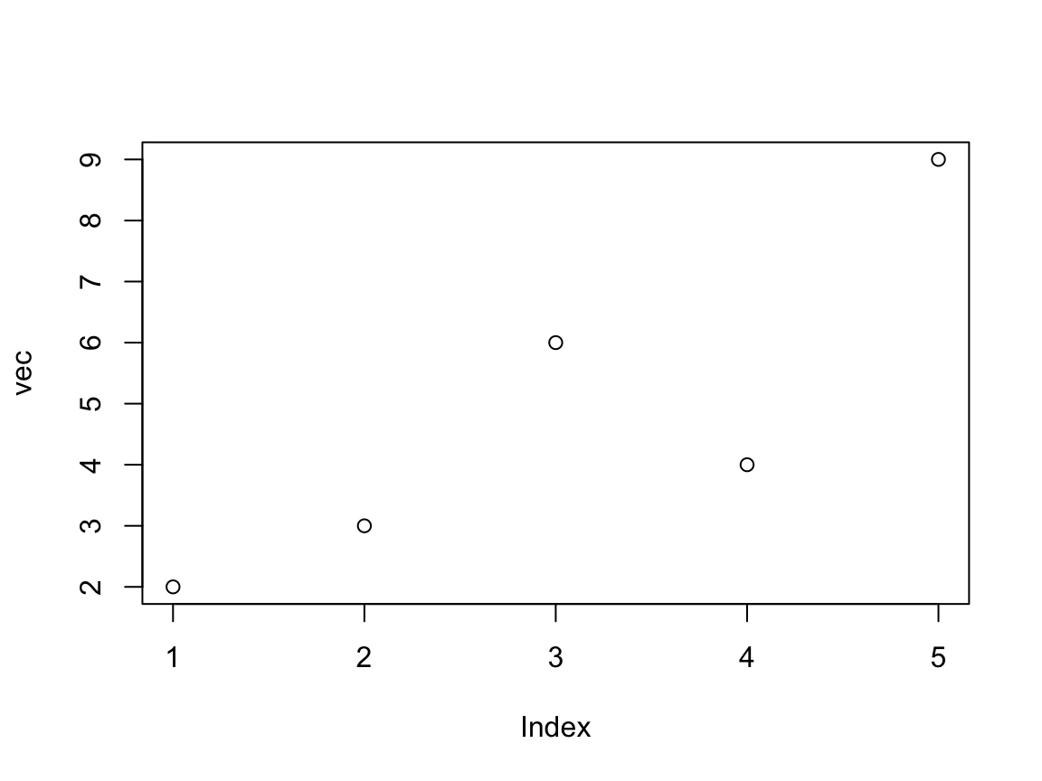
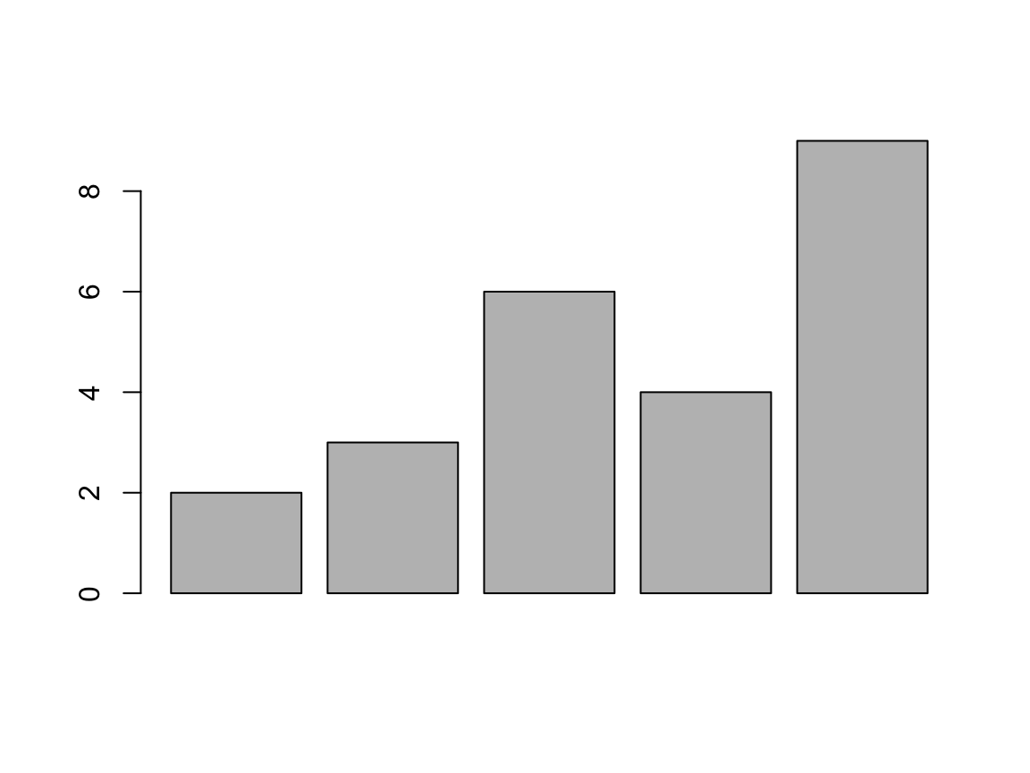
Data Visualisation - An Overview
Graphs can be easily generated with the base R syntax
plot(vec,
type = "l")
## some simple base R plots
vec <- c(2,3,6,4,9)
plot(vec)
plot(vec,
type = "o",
col = "blue")
barplot(vec)

Slide 6
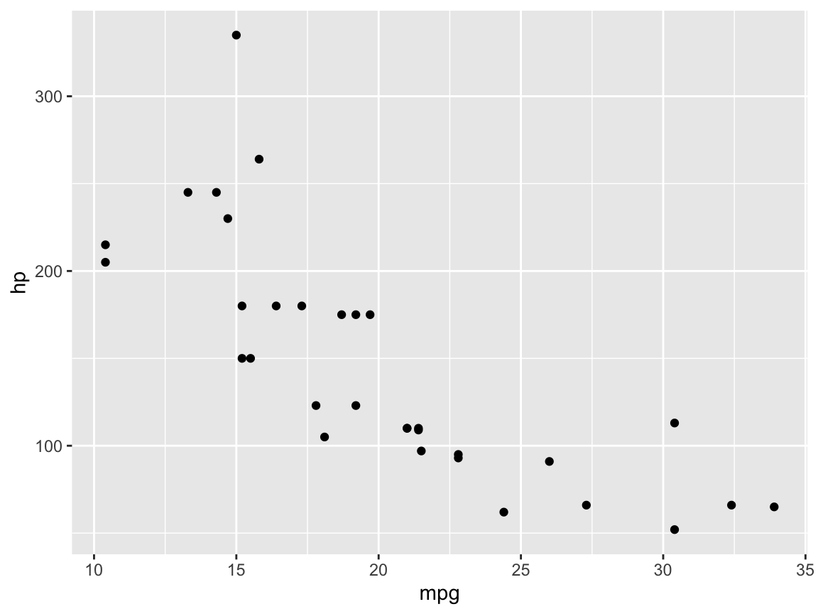
ggplot2
ggplot2 is a lot more useful and user friendly than base R, making plots look a lot nicer and with more options for building and displaying graphics
We’ll start with an old favourite, the mtcars dataset!
library(tidyverse) # This includes ggplot2! To just load that, library(ggplot2)
ggplot(data = mtcars) +
geom_point(mapping =
aes(x = mpg, y = hp))

Slide 7

ggplot2
ggplot() is the main function, and this creates the initial ggplot object where we then add multiple layers
A layer is a collection of geometric elements (geoms) and statistical transformations
An easy example of a “geom” element layer is geom_point(), which adds a scatter plot
Aesthetic mappings (aes) are specified with aes(). This is how variables (columns) in the input data are mapped to visual, or “aesthetic”, properties.
You can give global “aesthetics” to a plot (will appear in every layer) by specifying this in the ggplot() function, or local aesthetics in individual layers (such as in geom_point()).

Slide 8
ggplot2
ggplot(data = mtcars,
mapping = aes(x = mpg, y = hp)) +
geom_point()
We can also map the aesthetics via aes_string():
x_var <- "mpg”
y_var <- "hp”
ggplot(data = mtcars,
mapping = aes_string(x = x_var, y = y_var)) +
geom_point()

Slide 9
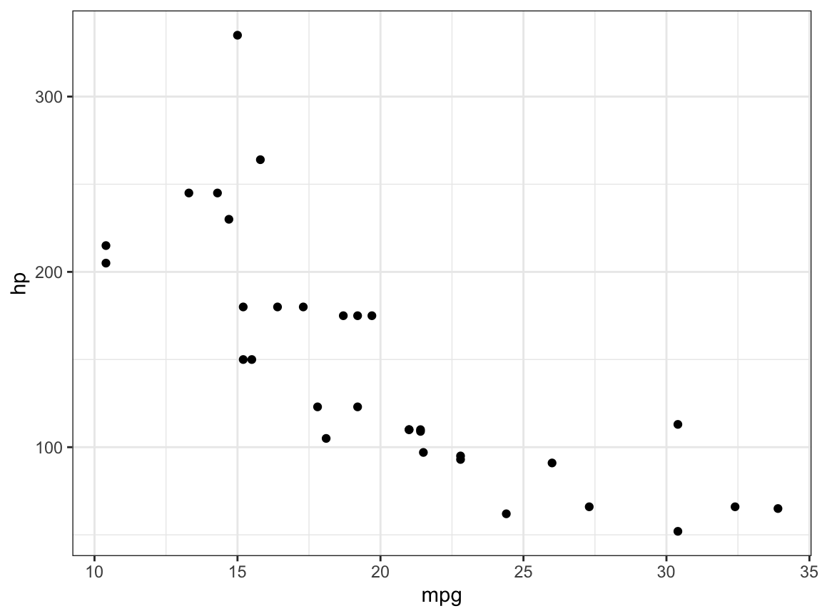
Themes
A “theme” controls the finer points of the plot, like the font size and background colour
This is essentially customising the non-data elements
For example, change the default grey background to white background
I personally prefer a white background
(the default is theme_grey())
ggplot(data = mtcars,
mapping = aes_string(x = x_var, y = y_var)) +
geom_point() +
theme_bw()

Slide 10
Themes
These themes can be set globally, so for all plots, using the theme_set() function
You can see some more themes provided by ggplot2
here:
https://r4ds.had.co.nz/graphics-for-communication.html#themes
theme_set(theme_bw())
ggplot(data = mtcars,
mapping = aes_string(x = x_var, y = y_var)) +
geom_point()

Slide 11
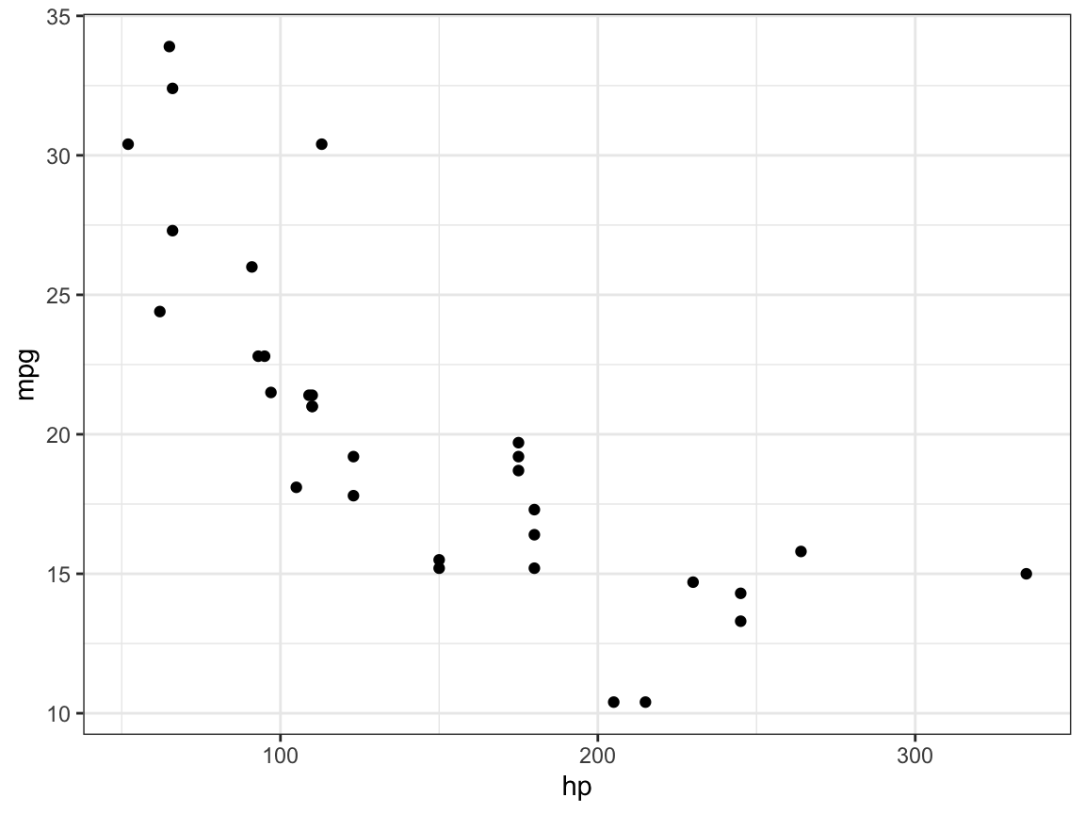
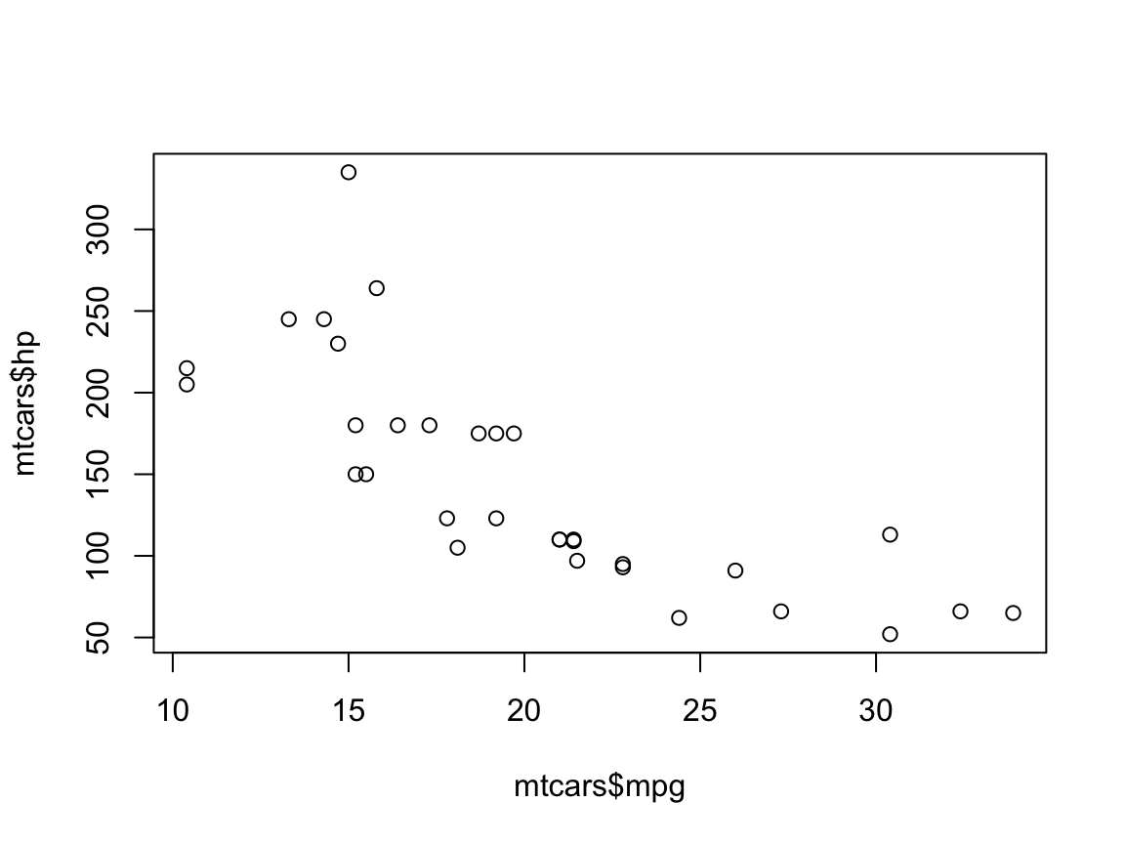
qplot()
A quicker version of ggplot! Good for very basic figures:
Which is exactly the same as:
qplot(mpg, hp, data = mtcars)
ggplot(mtcars, aes(hp ,mpg)) +
geom_point()
Same syntax as base plot() !
plot(mtcars$mpg, mtcars$hp)

Slide 12
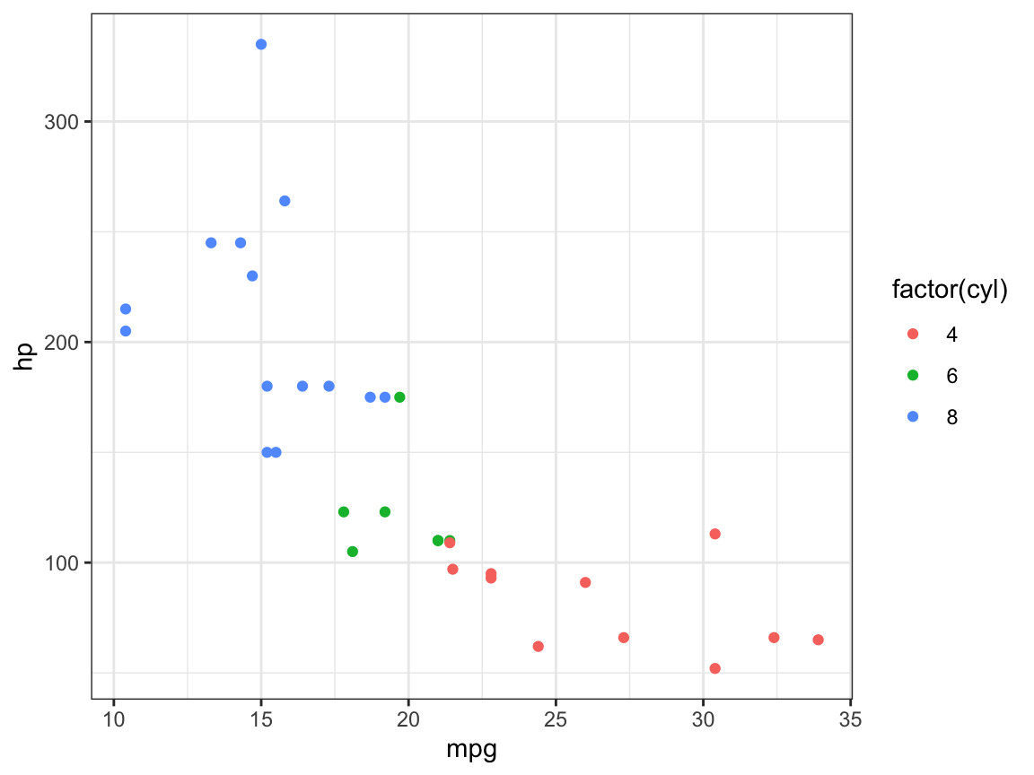
Aesthetics: Colour, Size and Shape
You can map a colour to data points by simply giving it the name of a colour (e.g. “brickred”), but mapping a variable to the data points can allow you to distinguish between different data points using different colour
For example, in mtcars we can map the number of cylinders to the colour aesthetic (or color if you want to spell it wrong…)
ggplot(data = mtcars,
mapping = aes(x = mpg,
y = hp,
colour = factor(cyl))) +
geom_point()

Slide 13
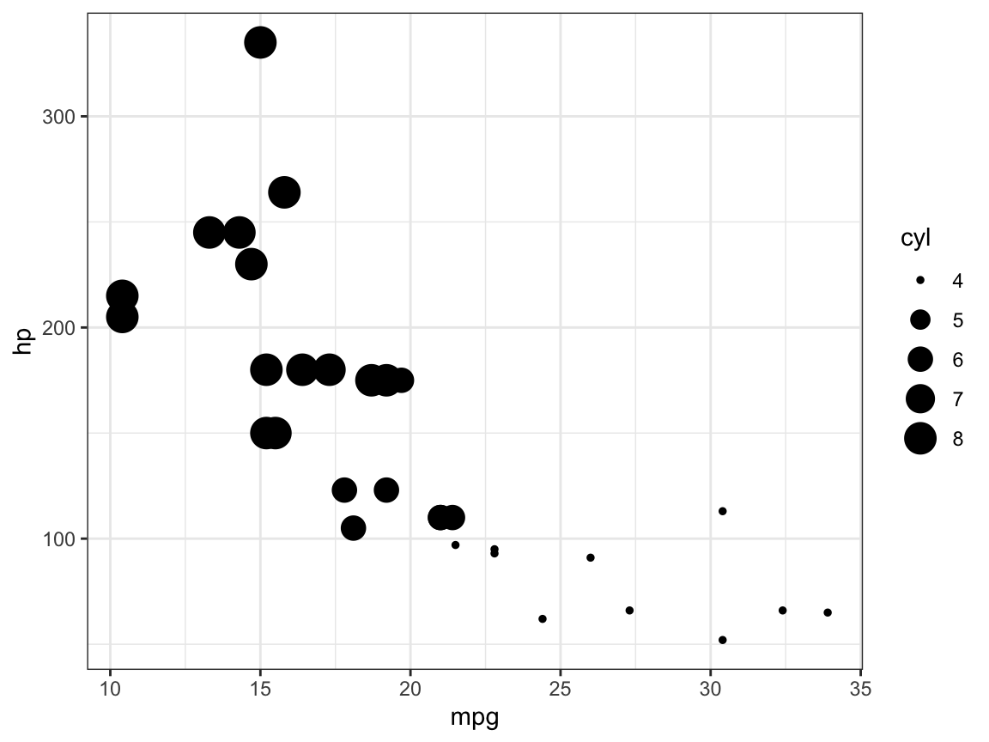
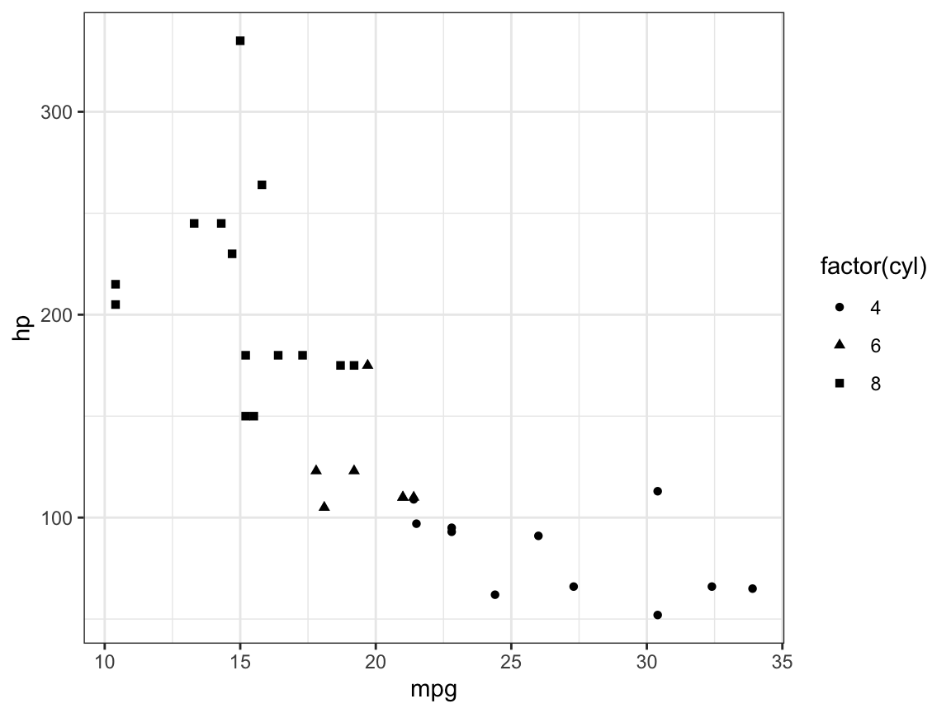
Aesthetics: Colour, Size and Shape
We can also map the number of cylinders to the size aesthetic:
Or even to the shape aesthetic:
ggplot(data = mtcars,
mapping = aes(x = mpg,
y = hp,
size = cyl)) +
geom_point()
ggplot(data = mtcars,
mapping = aes(x = mpg,
y = hp,
shape = factor(cyl))) +
geom_point()

Slide 14

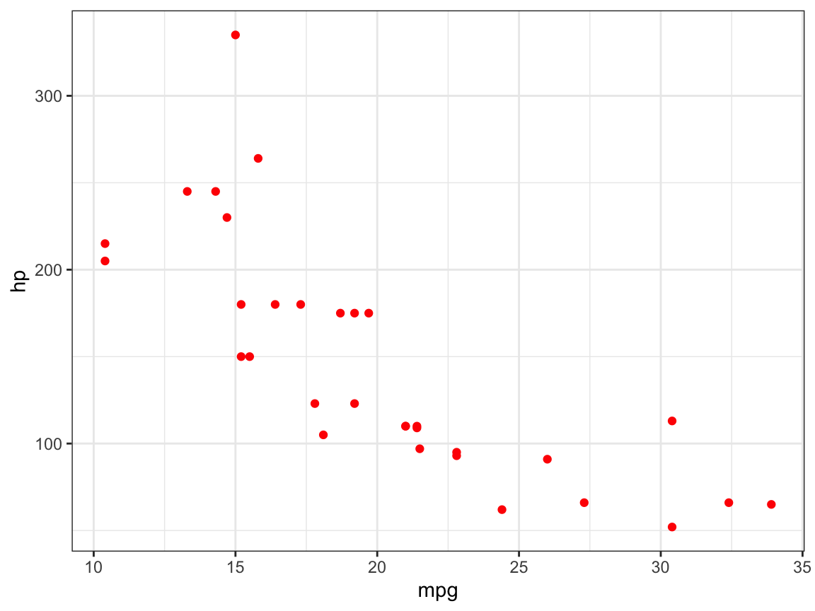
Aesthetics: Colour, Size and Shape
Or we can combine both colour and shape!
We can set an aesthetic locally outside of aes()
ggplot(data = mtcars,
mapping = aes(x = mpg,
y = hp,
shape = factor(cyl),
colour = factor(cyl))) +
geom_point()
ggplot(data = mtcars,
mapping = aes(x = mpg,
y = hp)) +
geom_point(colour = "red")

Slide 15
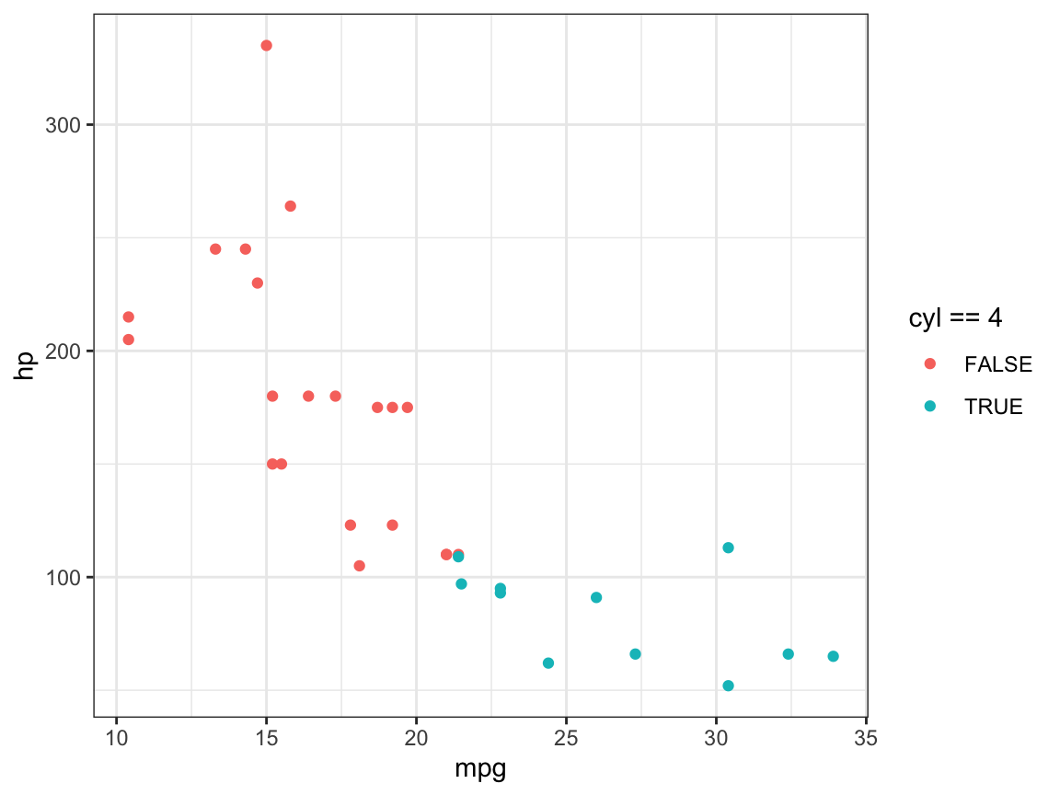
Aesthetics: Colour, Size and Shape
We can even map an aesthetic to a datapoint based on a condition, i.e. only change colour when a certain condition is met.
For example here, the colour varies depending on whether the car has 4 cylinders or not (cyl == 4 being TRUE or FALSE)
ggplot(data = mtcars,
mapping = aes(x = mpg,
y = hp,
colour = cyl == 4)) +
geom_point()

Slide 16
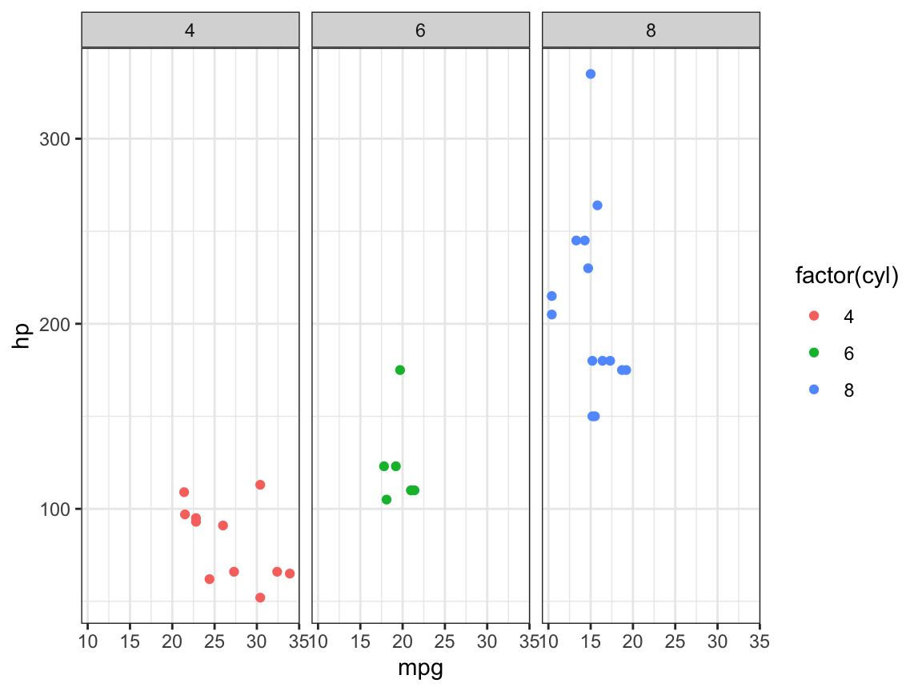
Facets
A ”facet” is one section of something that has many sections.
A ”dacet” in ggplot allows you to break up the data into different subsets and plot individual panels based on it
Creates “subplots” or panel-like figures
Really useful when you’ve got categorical variables (such as gender)
ggplot(data = mtcars,
mapping = aes(x = mpg,
y = hp,
colour = factor(cyl))) +
geom_point() +
facet_wrap(~ cyl)

Slide 17
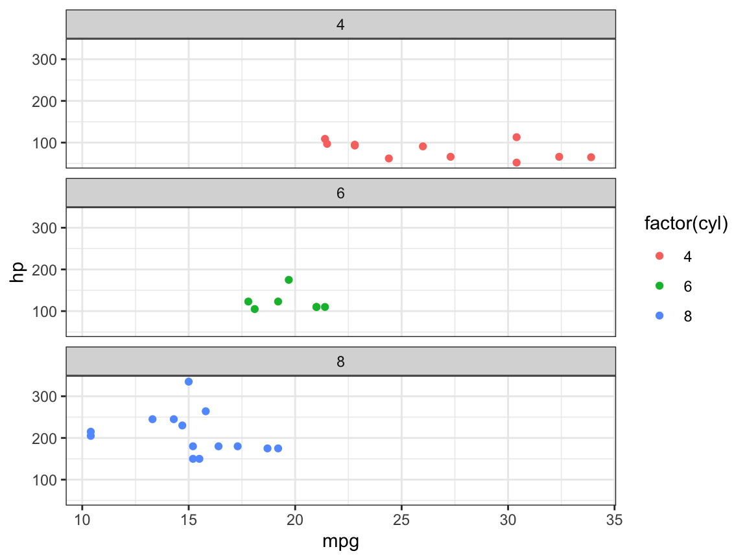
Facets
We can change the layout of the “facets” locally:
Which in this instance does the same thing as this:
ggplot(data = mtcars,
mapping = aes(x = mpg,
y = hp,
colour = factor(cyl))) +
geom_point() +
facet_wrap(~ cyl, ncol = 1)
ggplot(data = mtcars,
mapping = aes(x = mpg,
y = hp,
colour = factor(cyl))) +
geom_point() +
facet_wrap(~ cyl, dir = “v”) #vertical

Slide 18
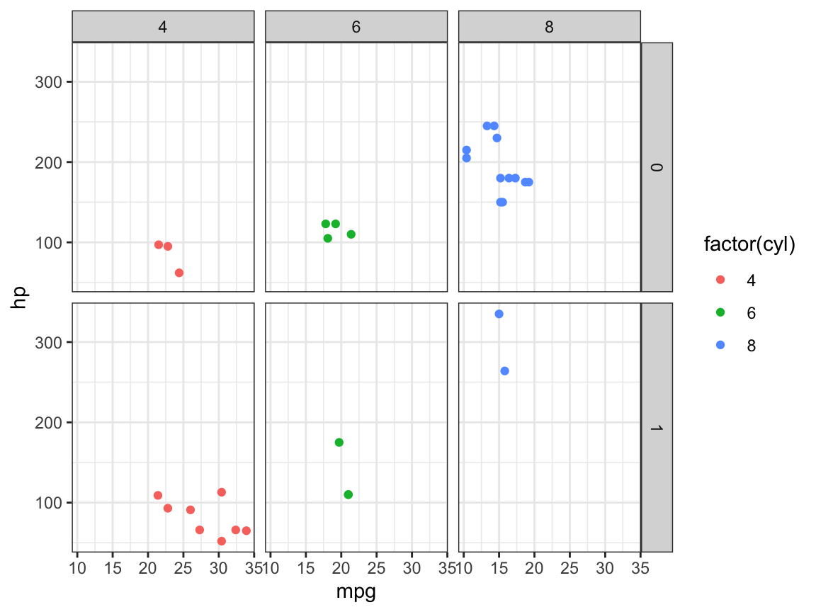
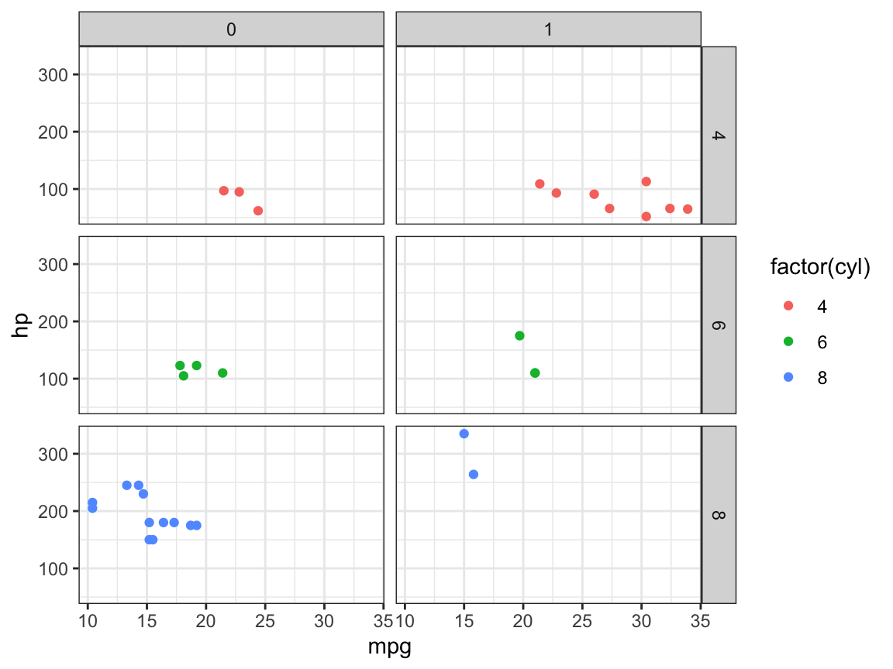
Facets
We can even combine 2 variables with facet_grid()
ggplot(data = mtcars,
mapping = aes(x = mpg,
y = hp,
colour = factor(cyl))) +
geom_point() +
facet_grid(am ~ cyl)
ggplot(data = mtcars,
mapping = aes(x = mpg,
y = hp,
colour = factor(cyl))) +
geom_point() +
facet_grid(cyl ~ am)

Slide 19
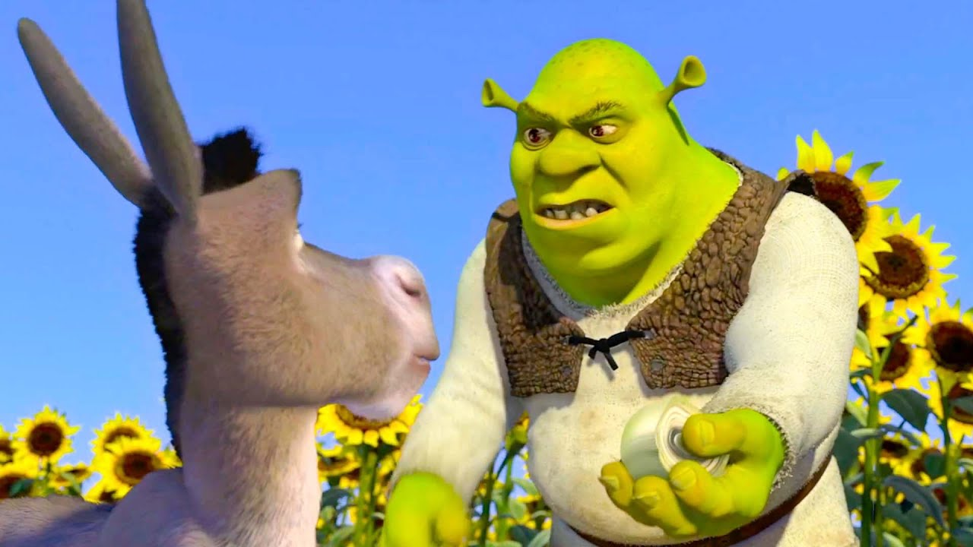
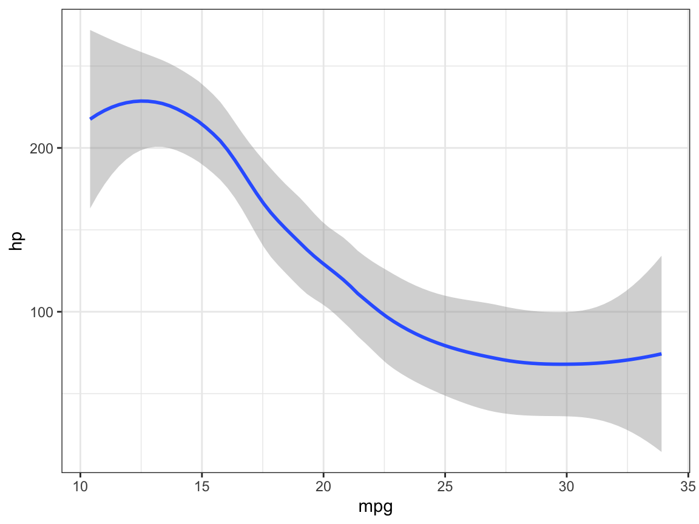
Other Geom Objects
So far we’ve only used the basic geom_point(), but there are a lot more than that!
geom_smooth() draws a smoothed line based on the trend of the provided data
You can use multiple geoms on the same plot (ggplots have layers!)
ggplot(data = mtcars,
mapping = aes(x = mpg,
y = hp)) +
geom_smooth()

Slide 20
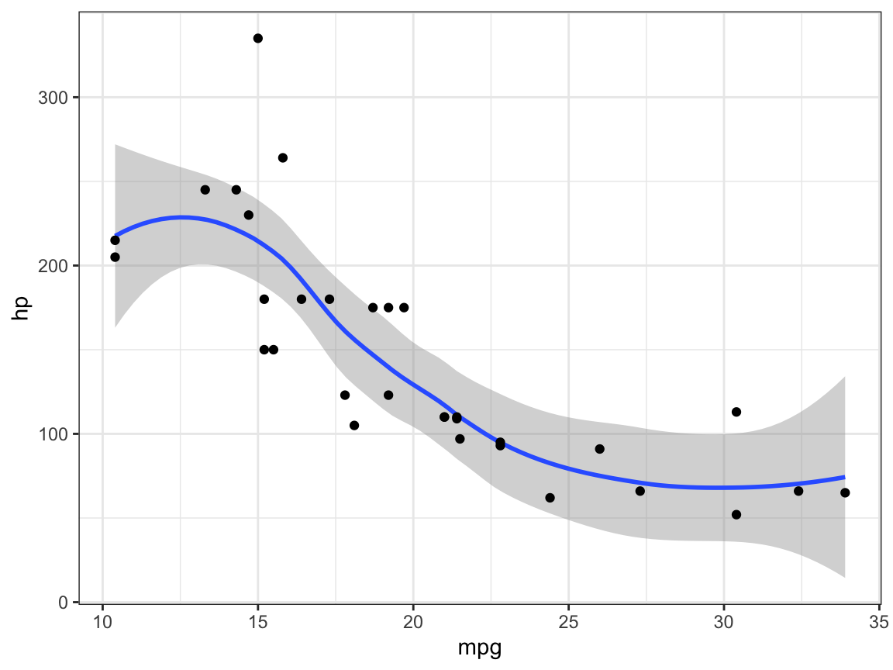
Other Geom Objects
Combining two LAYERS
Often the order of the layers matters, fortunately not in this case (if you swapped the geoms around it’ll be the same)
ggplot(data = mtcars,
mapping = aes(x = mpg,
y = hp)) +
geom_smooth() +
geom_point()

Slide 21
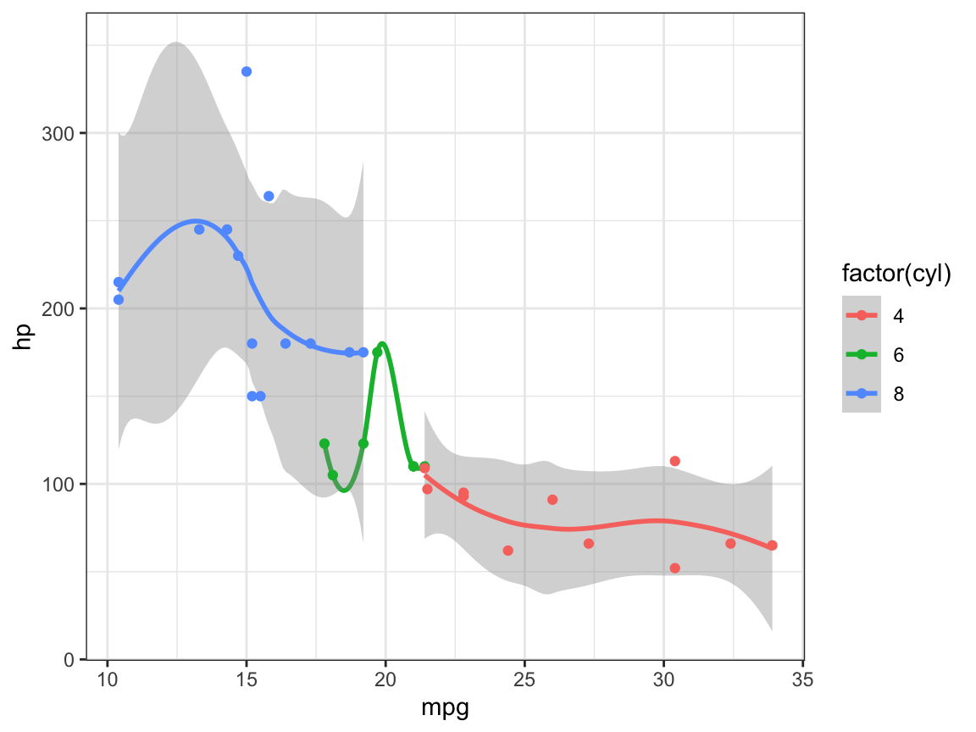
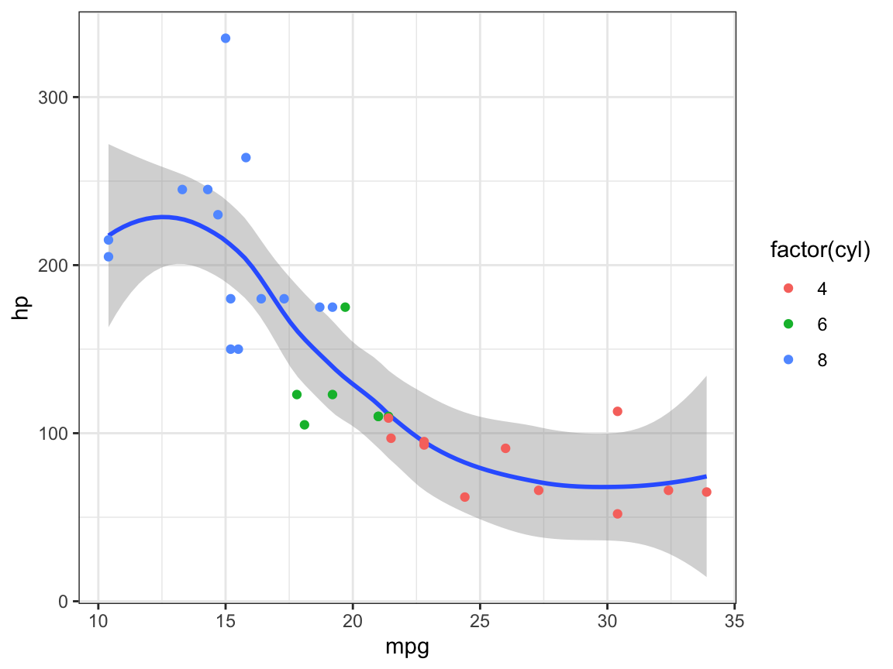
Other Geom Objects
Using the full data:
Locally mapped makes it look a lot better:
ggplot(data = mtcars,
mapping = aes(x = mpg,
y = hp,
colour = factor(cyl))) +
geom_smooth() +
geom_point()
ggplot(data = mtcars,
mapping = aes(x = mpg,
y = hp,
colour = factor(cyl))) +
geom_smooth() +
geom_point()

Slide 22
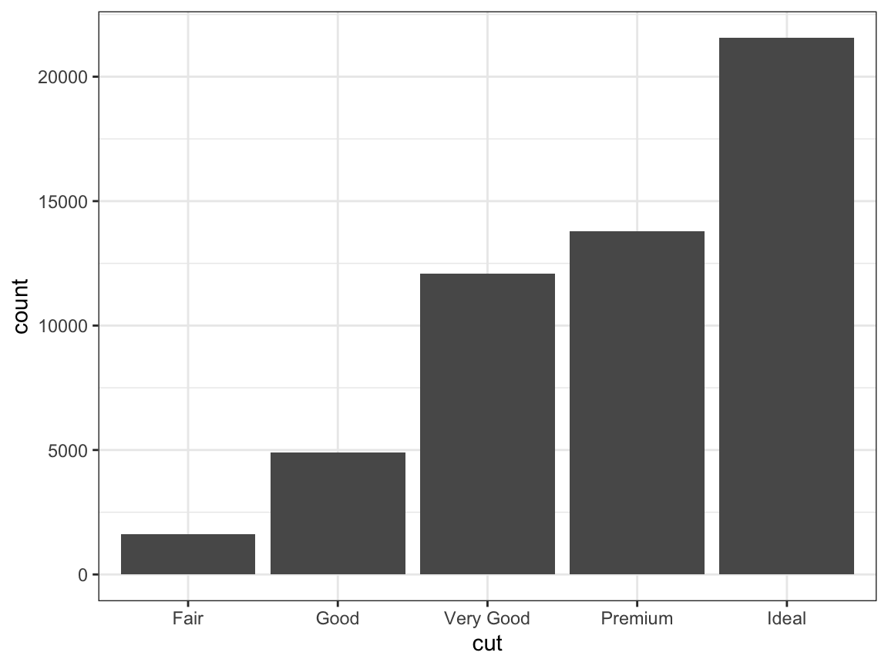
Statistical Transformations
Some plots transform your data internally and plot those new values instead of raw values
The stat argument of different plot types (geom functions) specifies the statistical transformation
For example, geom_bar() uses stat = "count" as it’s default to create counts of the mapped variable (as in what a bar chart does):
Worth noting, geom and stats are often
interchangeable
ggplot(data = diamonds) +
geom_bar(mapping = aes(x = cut))
ggplot(data = diamonds) +
stat_count(mapping = aes(x = cut))

Slide 23
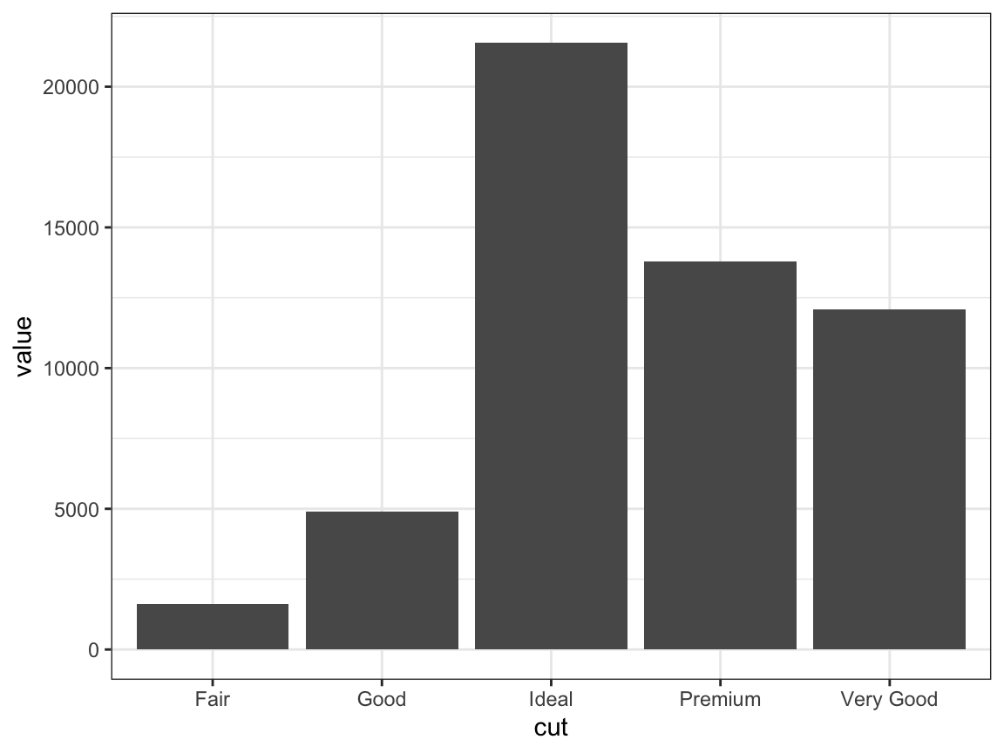
Statistical Transformations
Another commonly used stat is “identity” when plotting bars with heights based on raw values
## example tibble
demo <- tribble(
~cut, ~value,
"Fair", 1610,
"Good", 4906,
"Very Good", 12082,
"Premium", 13791,
"Ideal", 21551 )
ggplot(data = demo) +
geom_bar(mapping = aes(x = cut,
y = value),
stat = "identity")

Slide 24
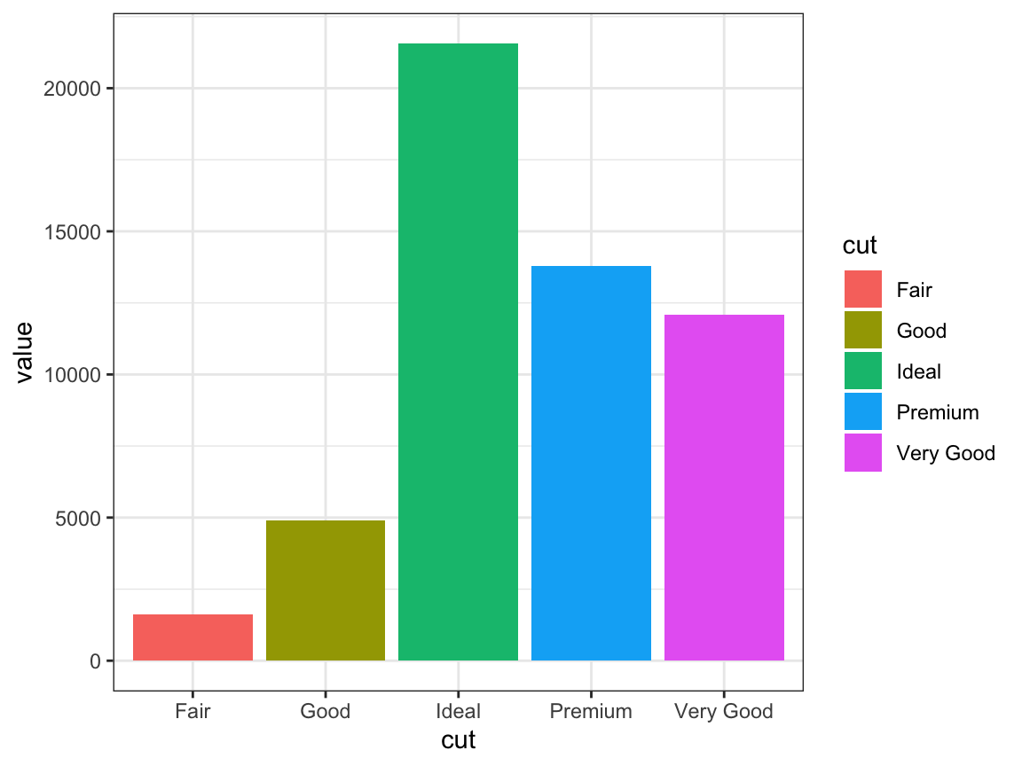
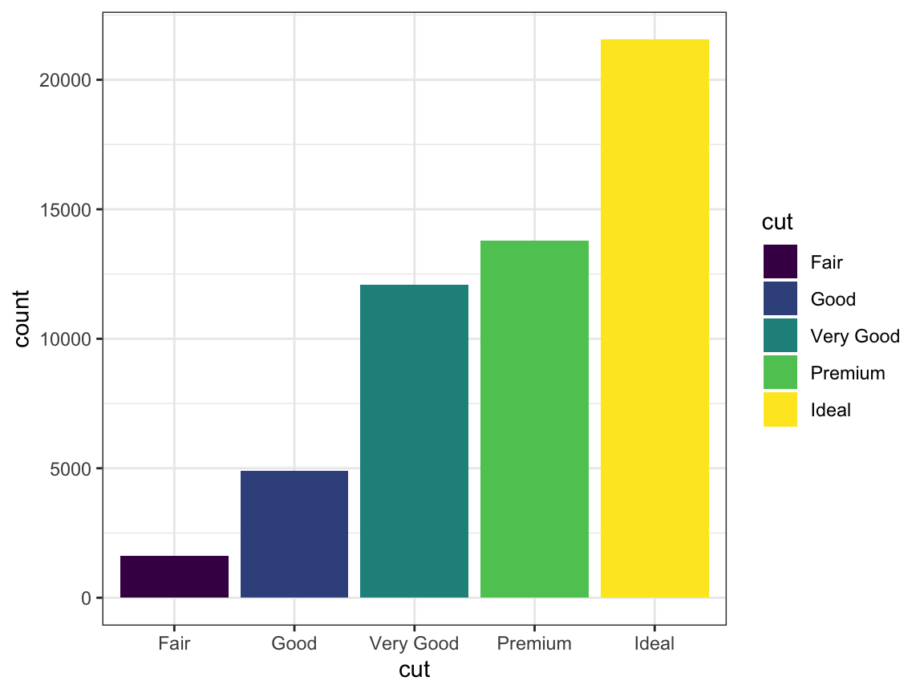
Statistical Transformations
Another common aesthetic is the “fill” argument:
ggplot(data = demo) +
geom_bar(mapping = aes(x = cut,
y = value,
fill = cut),
stat = "identity")
ggplot(data = demo) +
geom_bar(mapping = aes(x = cut,
y = value,
fill = cut),
stat = "identity")
ggplot(data = diamonds) +
geom_bar(mapping = aes(x = cut,
fill = cut)

Slide 25
B EAK!

Slide 26
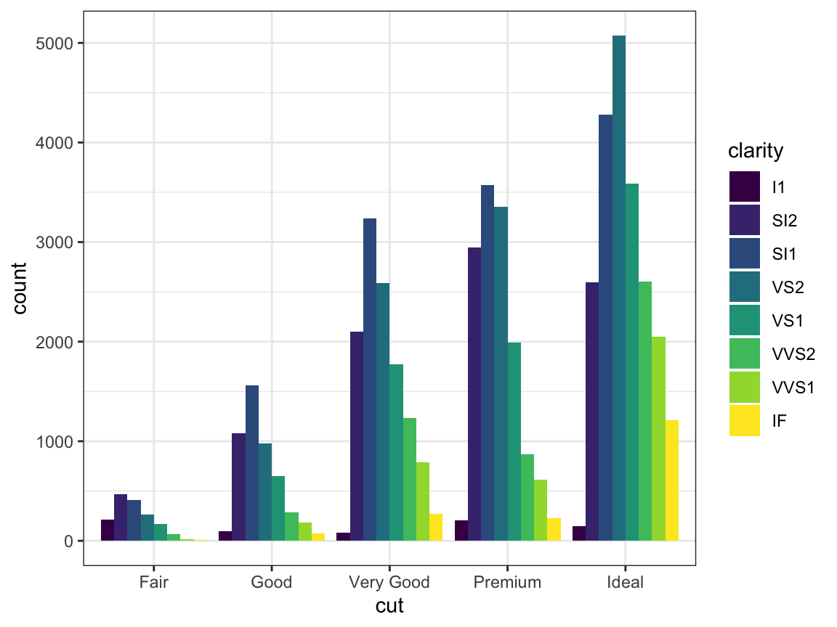
Positional Adjustments
This is how we can arrange geoms that would otherwise occupy the same space
You can do this by setting a value for the position argument of geom
# side by side
ggplot(data = diamonds) +
geom_bar(mapping = aes(x = cut,
fill = clarity),
position = "dodge")

Slide 27
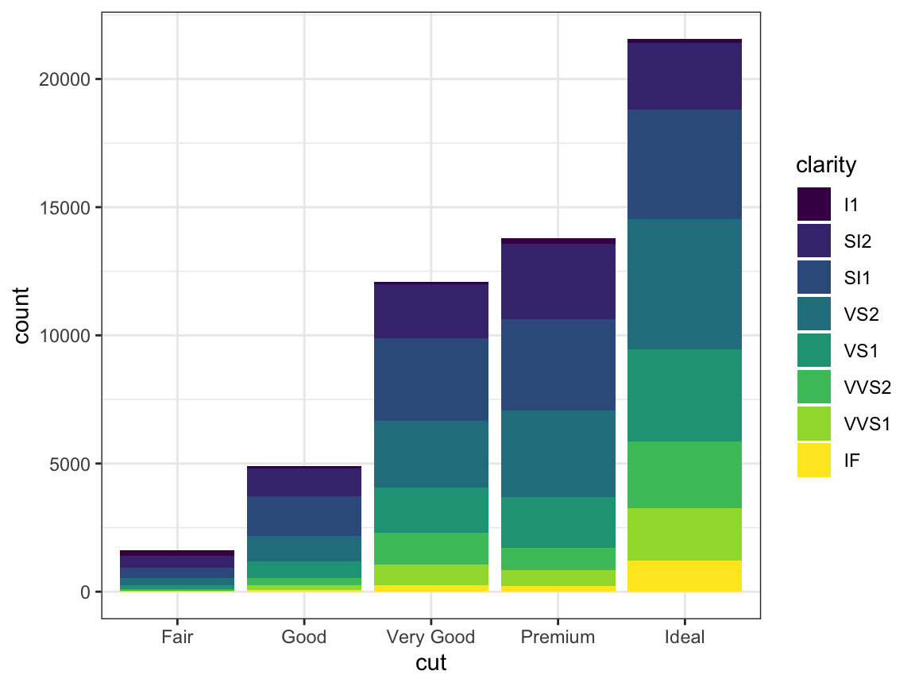
Positional Adjustments
The position argument “stack” stacks them on top of each other
# stack elements on top of each other
ggplot(data = diamonds) +
geom_bar(mapping = aes(x = cut,
fill = clarity),
position = "stack")

Slide 28
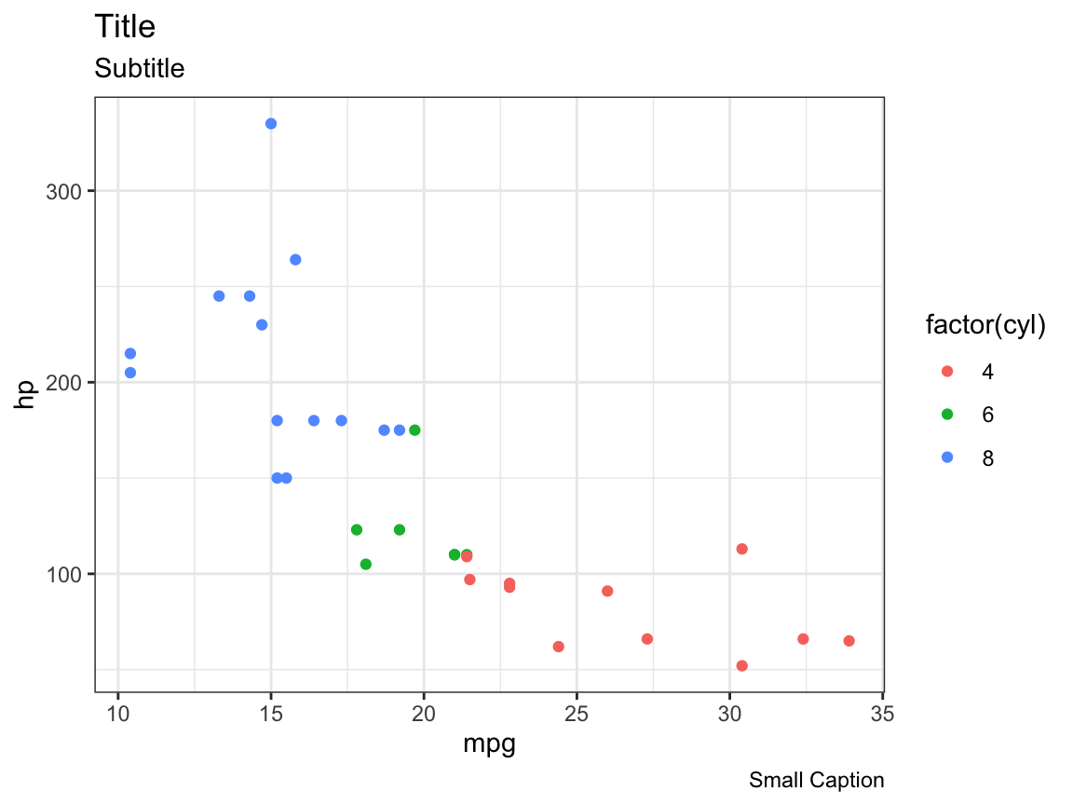
Labels
Another editable part of a plot are the text labels, which we can add or modify using labs()
ggplot(data = mtcars,
mapping = aes(x = mpg,
y = hp)) +
geom_point(aes(color = factor(cyl))) +
labs(
title = "Title",
subtitle = "Subtitle",
caption = "Small Caption”
)

Slide 29
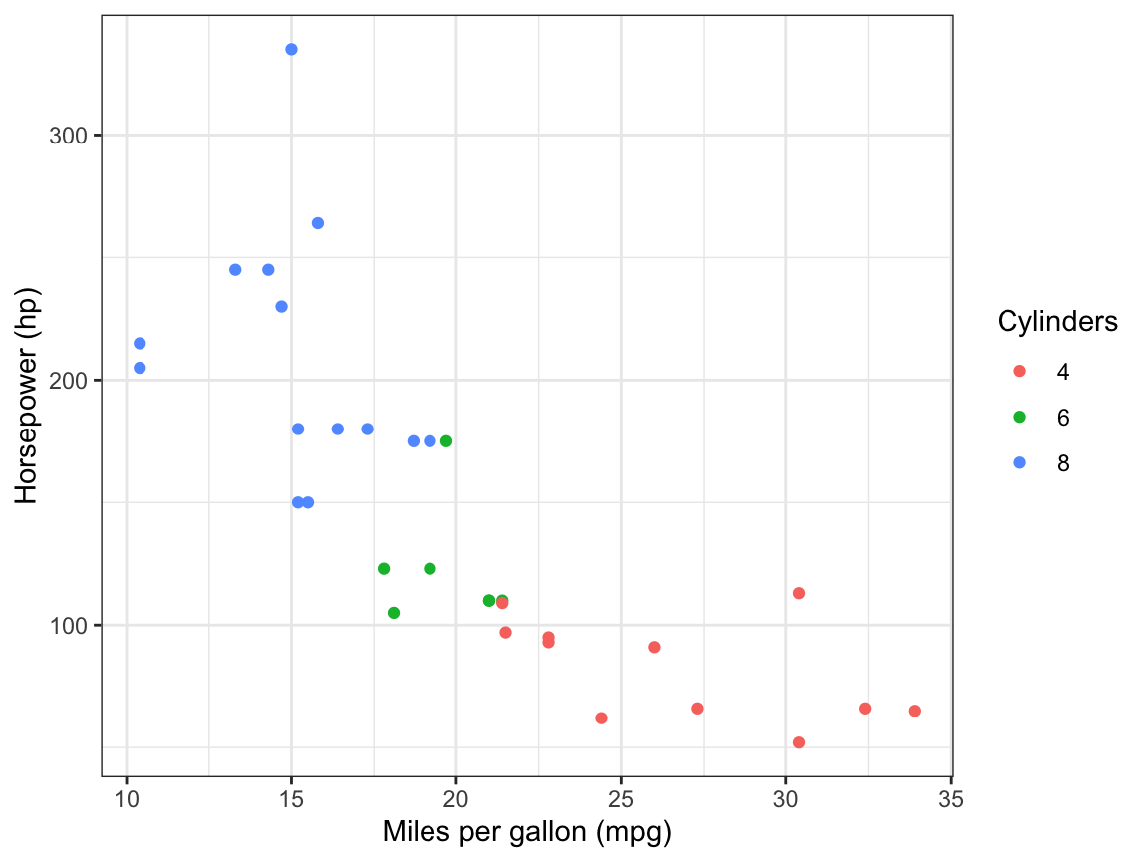
Labels
labs() also lets you modify axis and legend labels
ggplot(data = mtcars,
mapping = aes(x = mpg,
y = hp)) +
geom_point(aes(color = factor(cyl))) +
labs(
x = "Miles per gallon (mpg)",
y = "Horsepower (hp)",
colour = "Cylinders”
)

Slide 30
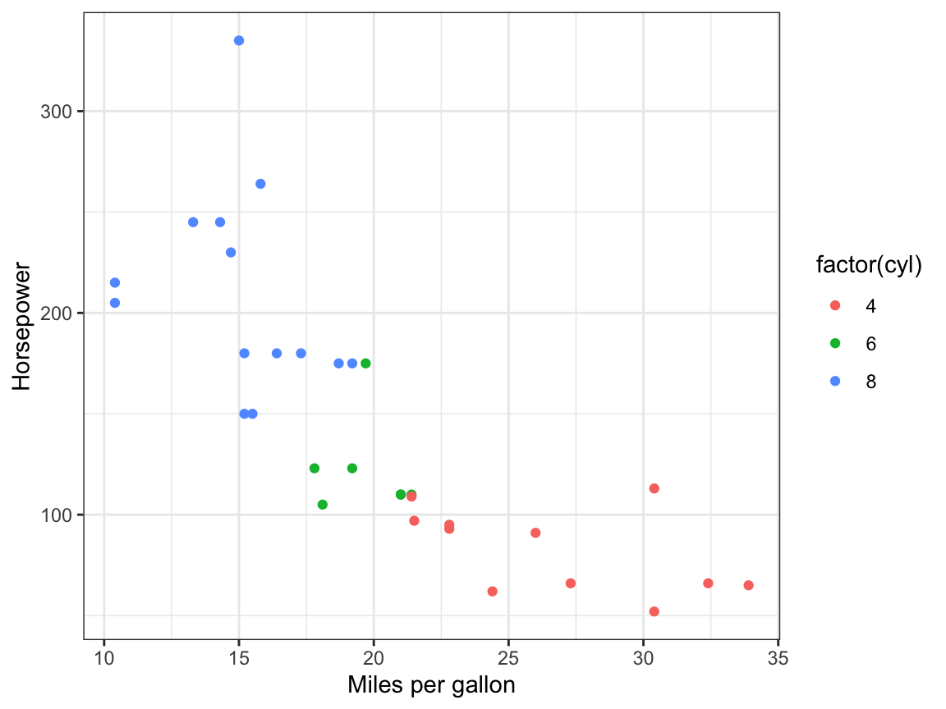
Labels
Sometimes a useful short-cut can be to use xlabs()or ylabs() to specifically define each of the axes
ggplot(data = mtcars,
mapping = aes(x = mpg,
y = hp)) +
geom_point(aes(color = factor(cyl))) +
xlab("Miles per gallon") +
ylab("Horsepower")

Slide 31
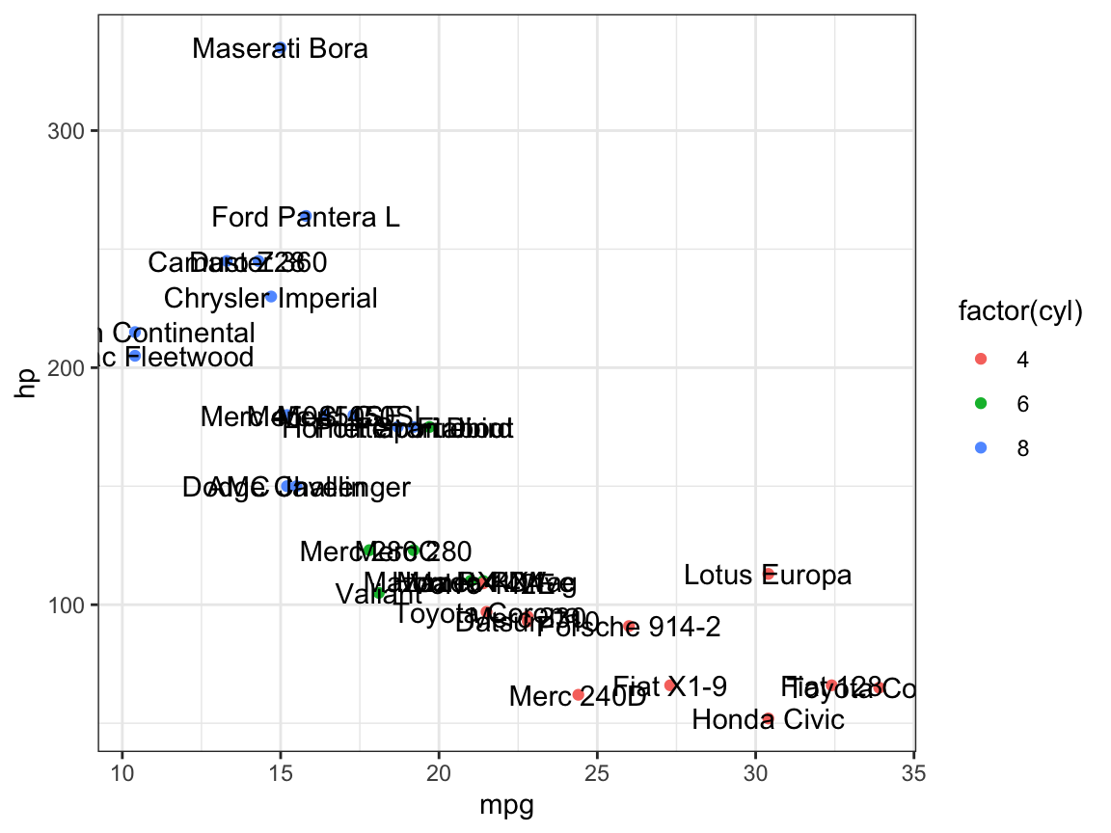
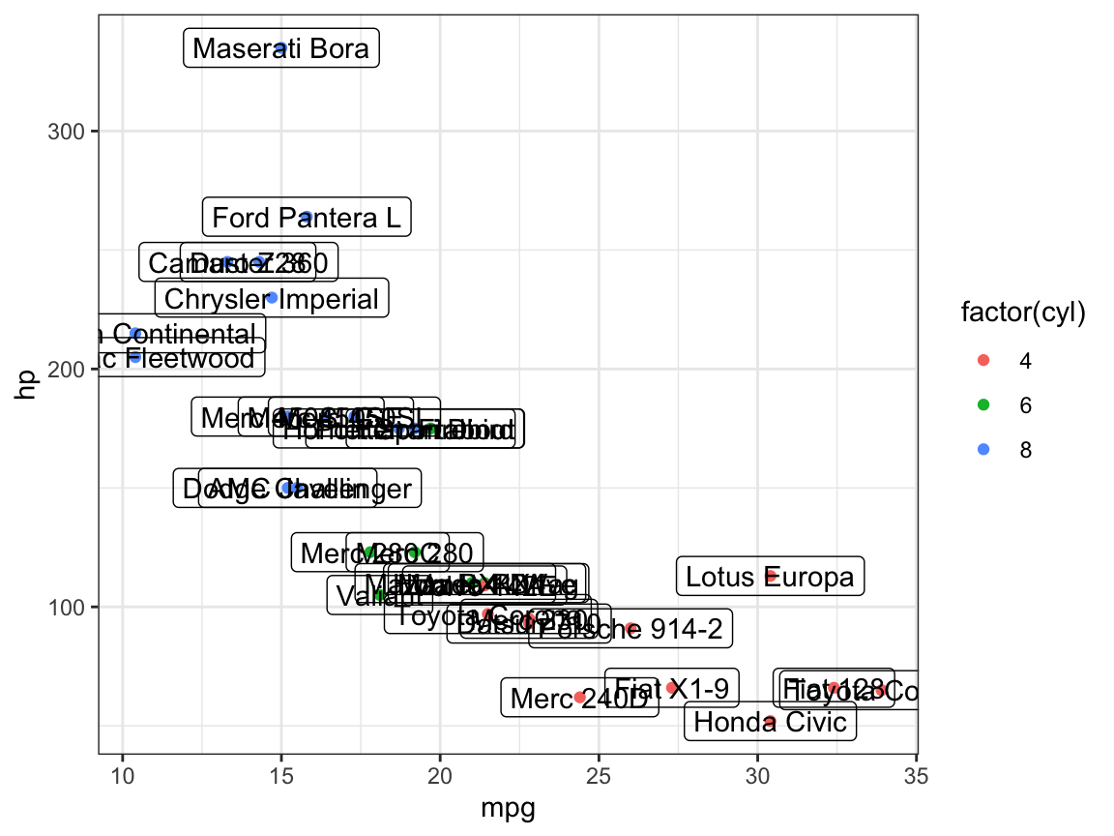
Annotations
To add annotation to data points, we can use geom_text() and geom_label()
ggplot(data = mtcars,
mapping = aes(x = mpg,
y = hp)) +
geom_point(aes(color = factor(cyl))) +
geom_text(aes(label = rownames(mtcars)))
ggplot(data = mtcars,
mapping = aes(x = mpg,
y = hp)) +
geom_point(aes(color = factor(cyl))) +
geom_label(aes(label = rownames(mtcars)),
alpha = 0)

Slide 32
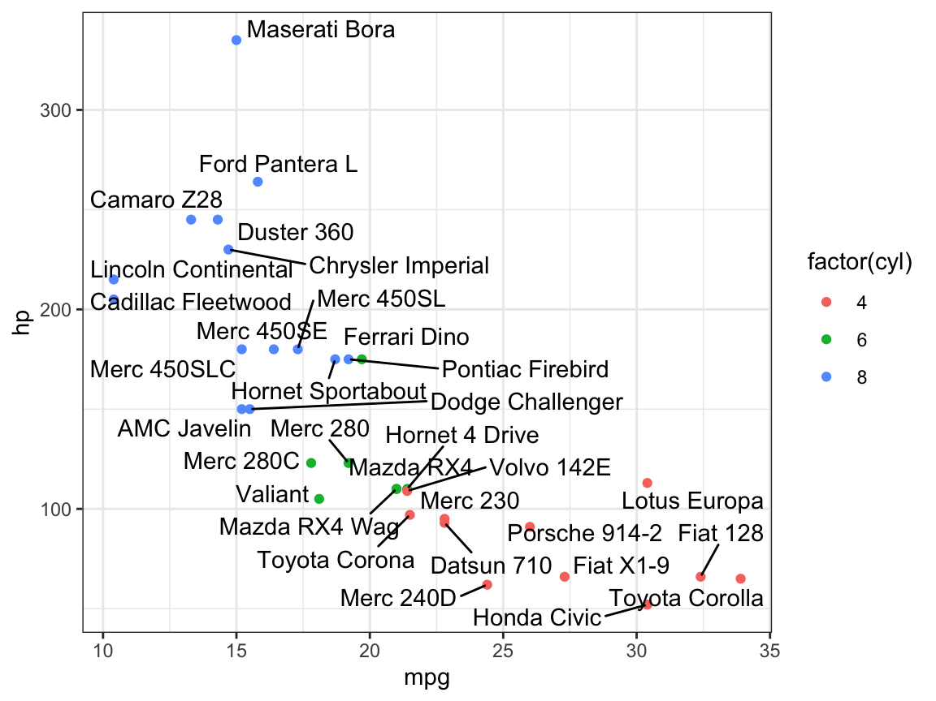
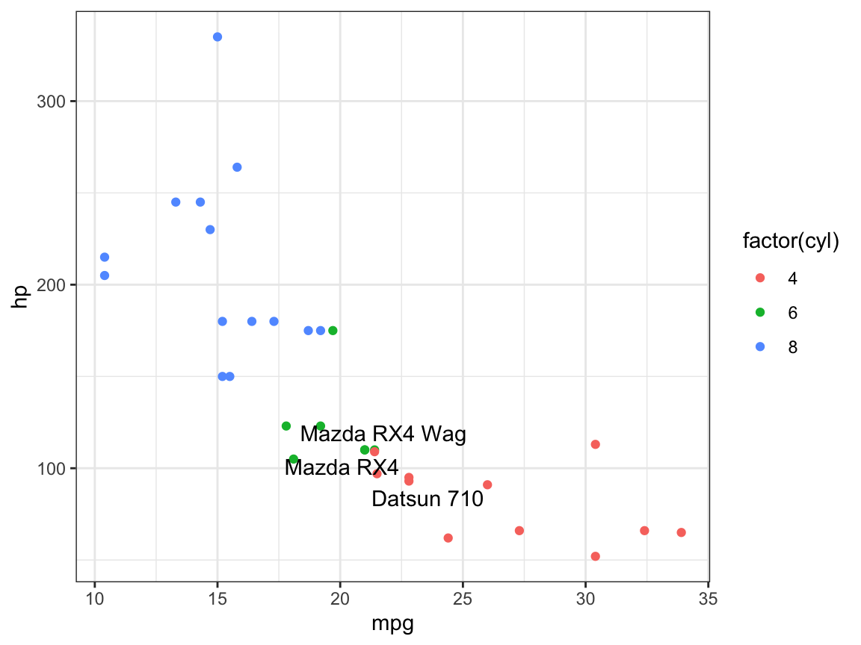
Annotations
These look a bit messy though, the package ggrepel helps to avoid overlapping within plots
# install.packages("ggrepel")
ggplot(data = mtcars,mapping = aes(x = mpg,
y = hp)) +
geom_point(aes(color = factor(cyl))) +
ggrepel::geom_text_repel(aes(
label = rownames(mtcars)),
max.overlaps = 100)
ggplot(data = mtcars,mapping = aes(x = mpg,
y = hp)) +
geom_point(aes(color = factor(cyl))) +
ggrepel::geom_text_repel(aes(label =
rownames(mtcars[1:3, ])),
data = mtcars[1:3, ])

Slide 33
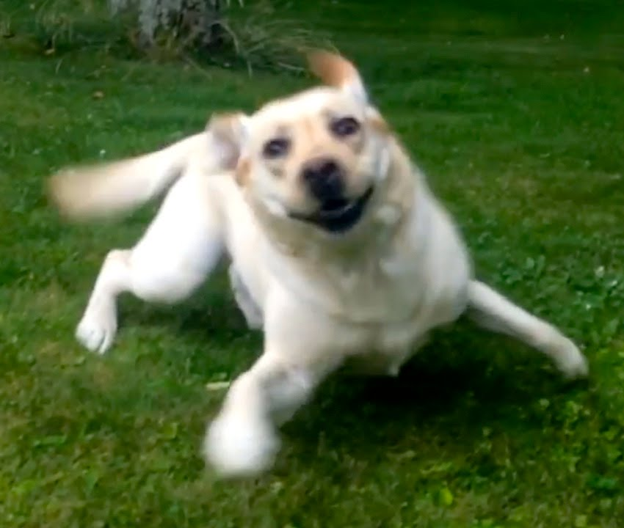
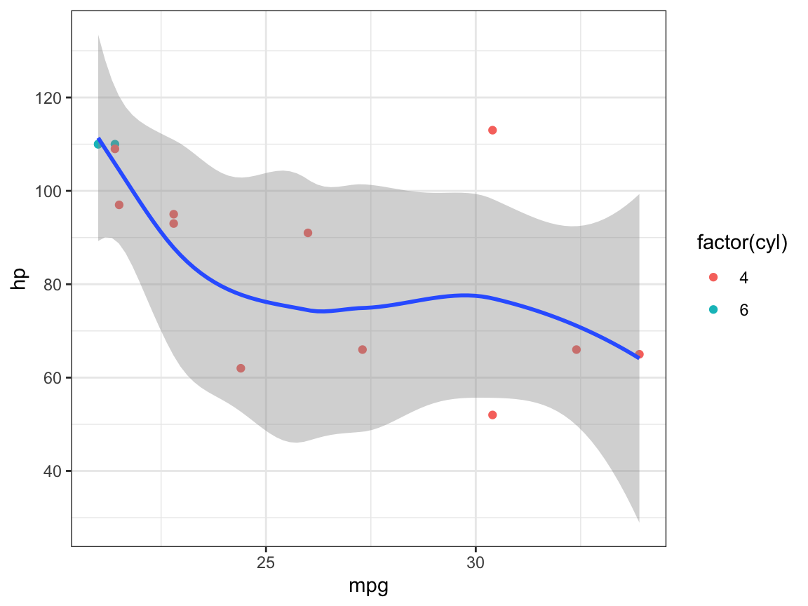
Zooming
To control the plot limits, you have 3 methods:
Adjusting the data that’s plotted
Setting xlim and ylim in coord_cartesian() (do this!!)
Setting the limits in each scale
This is adjusting the data
mtcars %>%
filter(mpg >= 20, hp <= 150) %>%
ggplot(mapping = aes(x = mpg, y = hp)) +
geom_point(aes(color = factor(cyl))) +
geom_smooth()

Slide 34
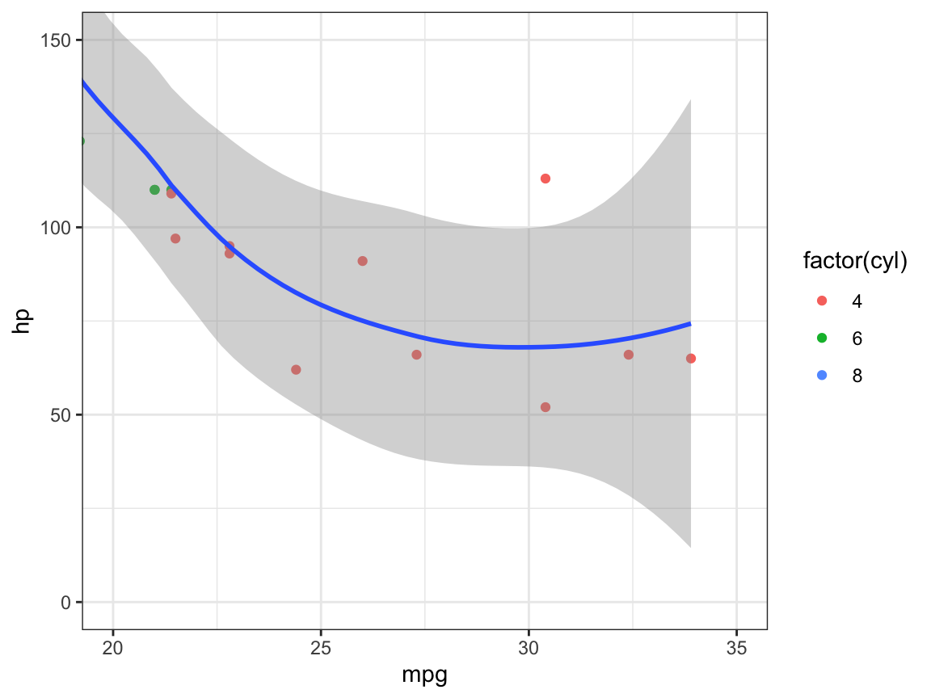
Zooming
This is the RIGHT WAY ☺, using coord_cartesian()
ggplot(data = mtcars,
mapping = aes(x = mpg,
y = hp)) +
geom_point(aes(color = factor(cyl))) +
geom_smooth() +
coord_cartesian(xlim = c(20, 35),
ylim = c(0, 150))

Slide 35
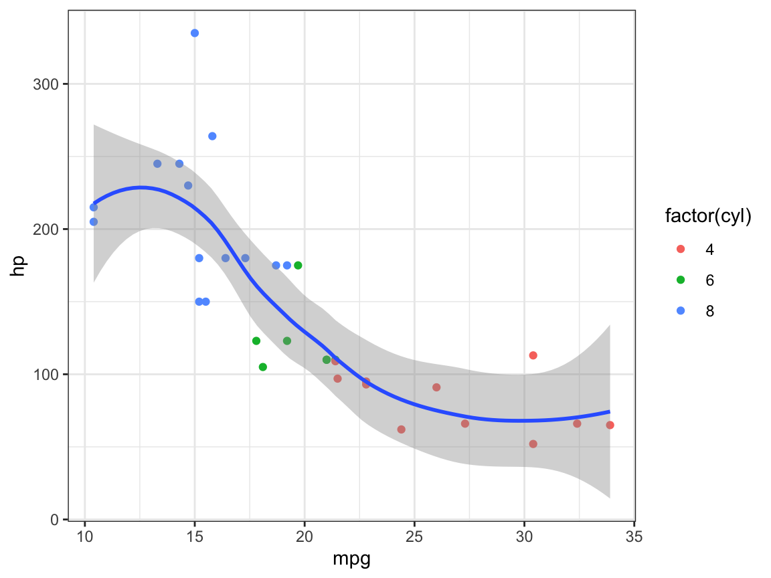
Zooming
And this is setting the limits in each scale
ggplot(data = mtcars,
mapping = aes(x = mpg,
y = hp)) +
geom_point(aes(color = factor(cyl))) +
geom_smooth()

Slide 36
Scales
“scale” allows you control mapping things like colour, size and shape to data values
“scale” draws a legend or axes
ggplot2 automatically adds default scales behind the scenes
ggplot(mtcars, aes(x = mpg,
y = hp)) +
geom_point(aes(color = factor(cyl)))

Slide 37
Scales
Is the same as:
Because we haven’t set them
ggplot has given them default values
ggplot(mtcars, aes(x = mpg,
y = hp)) +
geom_point(aes(color = factor(cyl))) +
scale_x_continuous() +
scale_y_continuous() +
scale_colour_discrete()

Slide 38
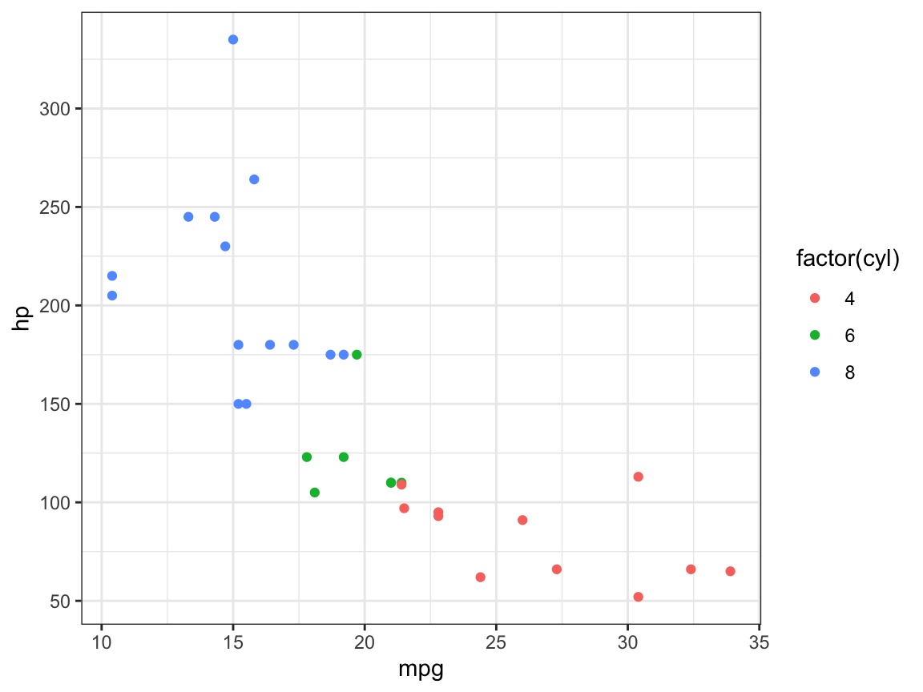
Scales
Have a look at the naming scheme:
‘scale_’
The name of the aesthetic (x_, y_, colour_, fill_…)
The name of the scale (continuous, discrete)
Changes to axes with arguments breaks and labels
Breaks
ggplot(mtcars, aes(x = mpg,
y = hp)) +
geom_point(aes(color = factor(cyl))) +
scale_y_continuous(
breaks = seq(0, 350, by = 50))

Slide 39
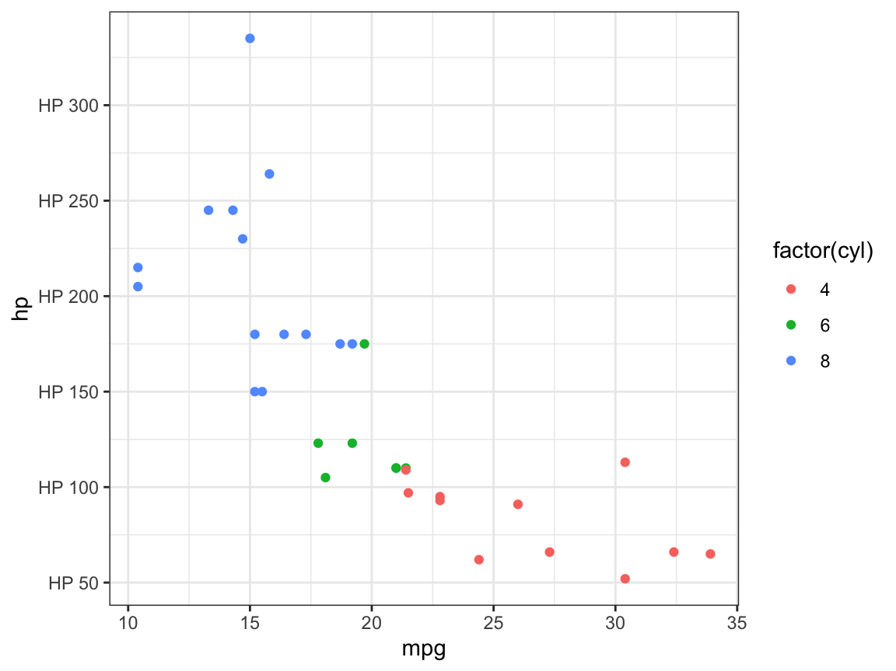
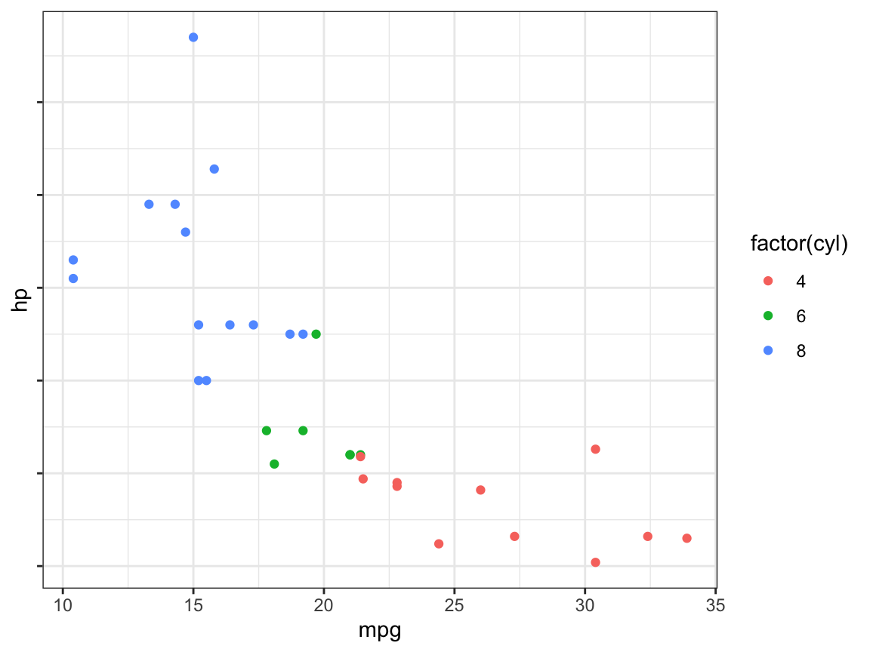
Scales
Labels!
Or no labels X
ggplot(mtcars, aes(x = mpg,
y = hp)) +
geom_point(aes(color = factor(cyl))) +
scale_y_continuous(
breaks = seq(0, 350, by = 50),
labels = paste0("HP ", seq(0, 350, by = 50)))
ggplot(mtcars, aes(x = mpg,
y = hp)) +
geom_point(aes(color = factor(cyl))) +
scale_y_continuous(
breaks = seq(0, 350, by = 50),
labels = NULL)

Slide 40
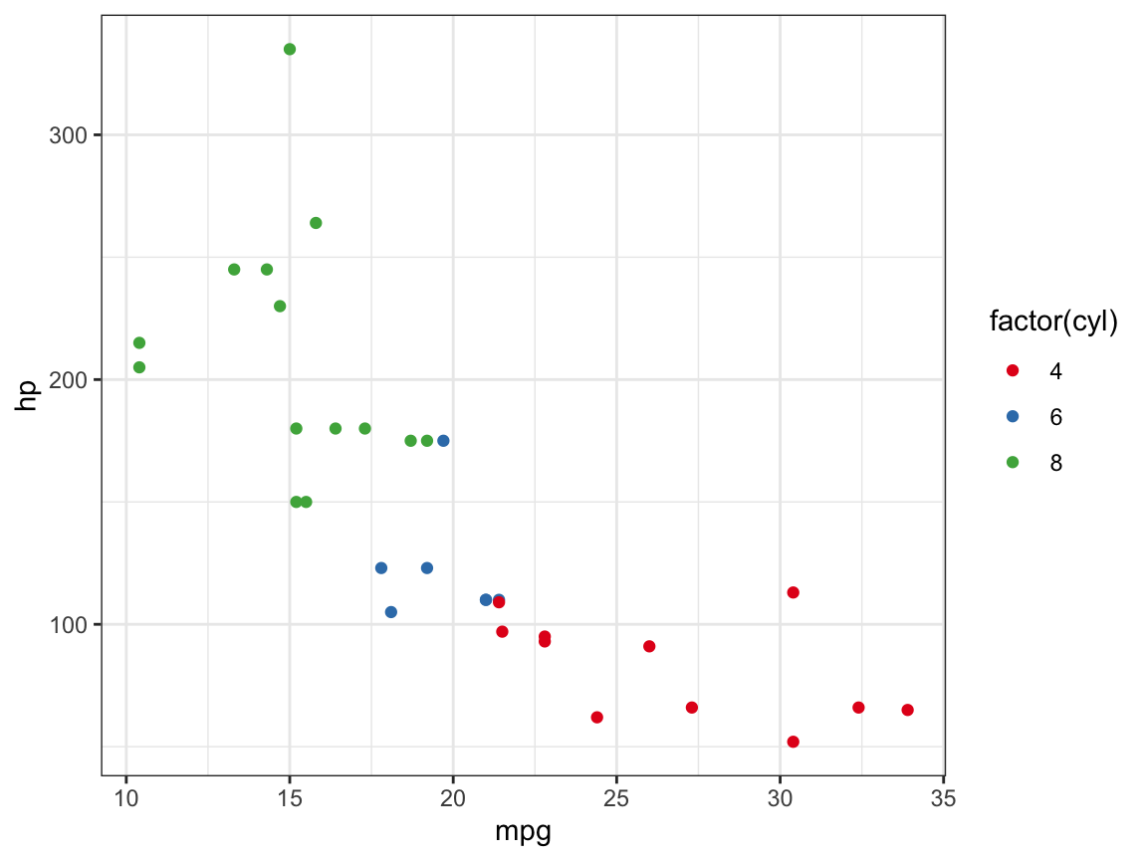
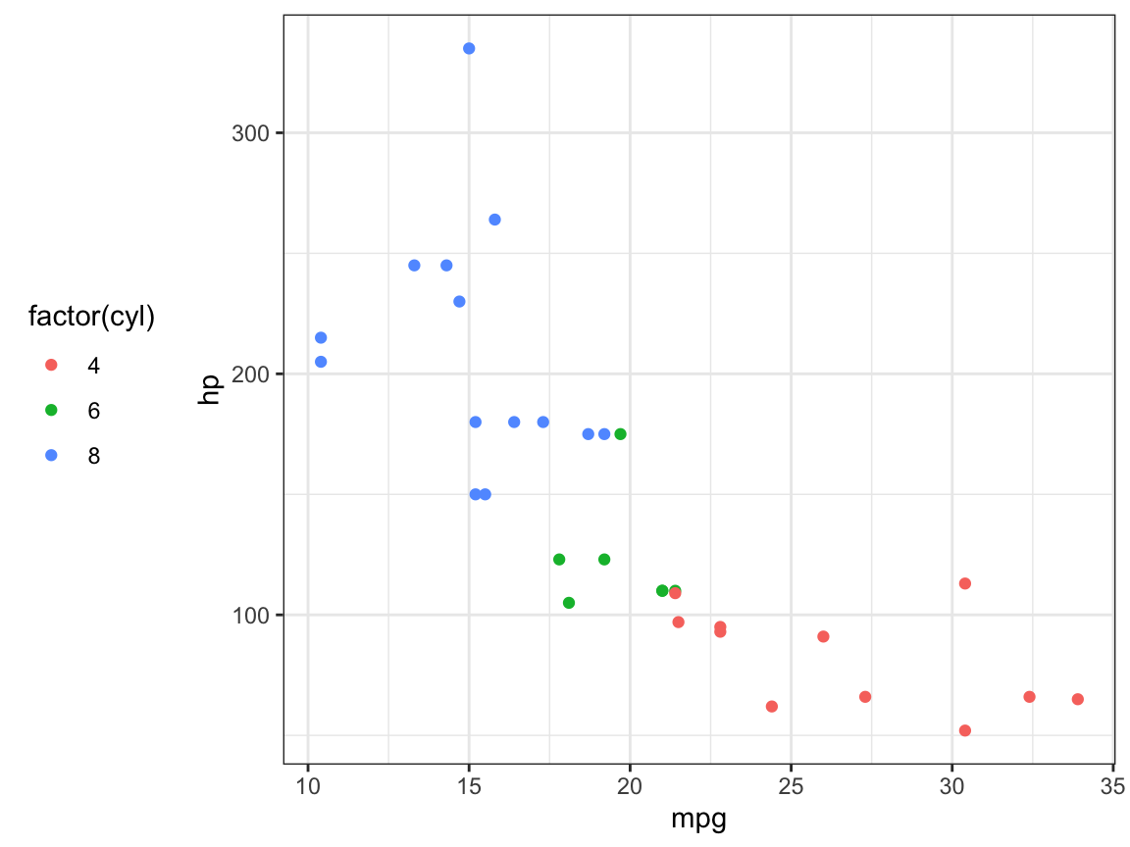
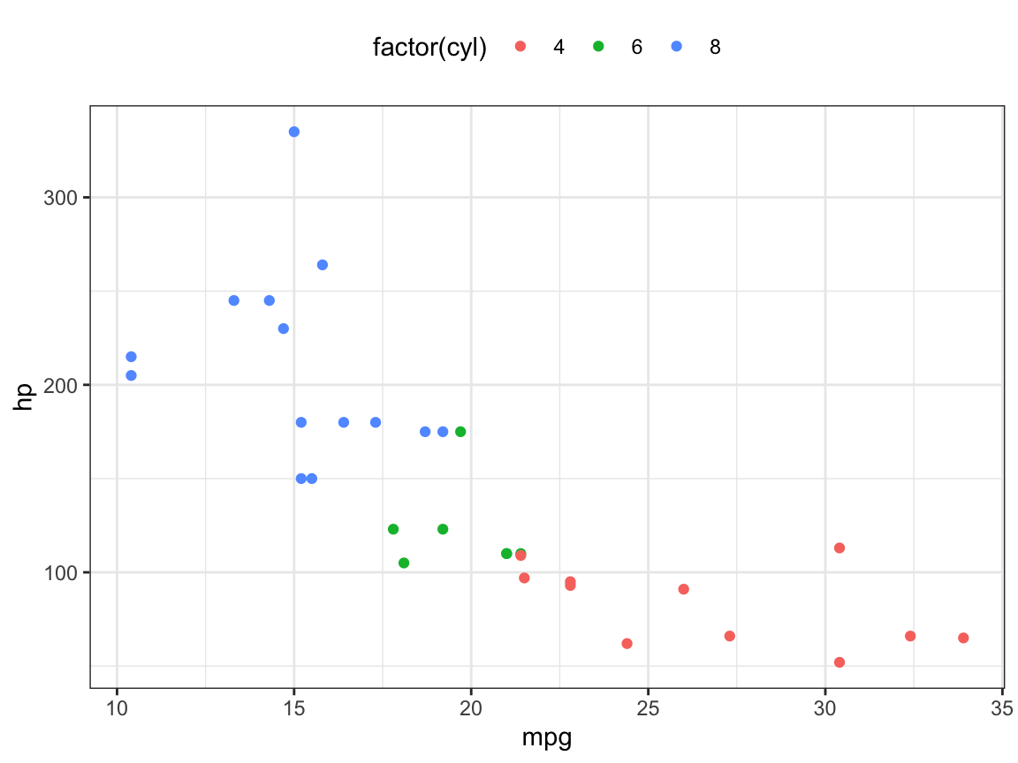
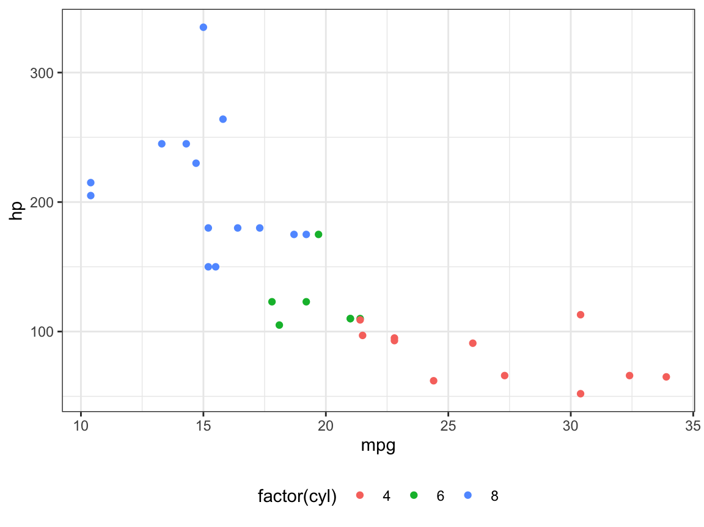
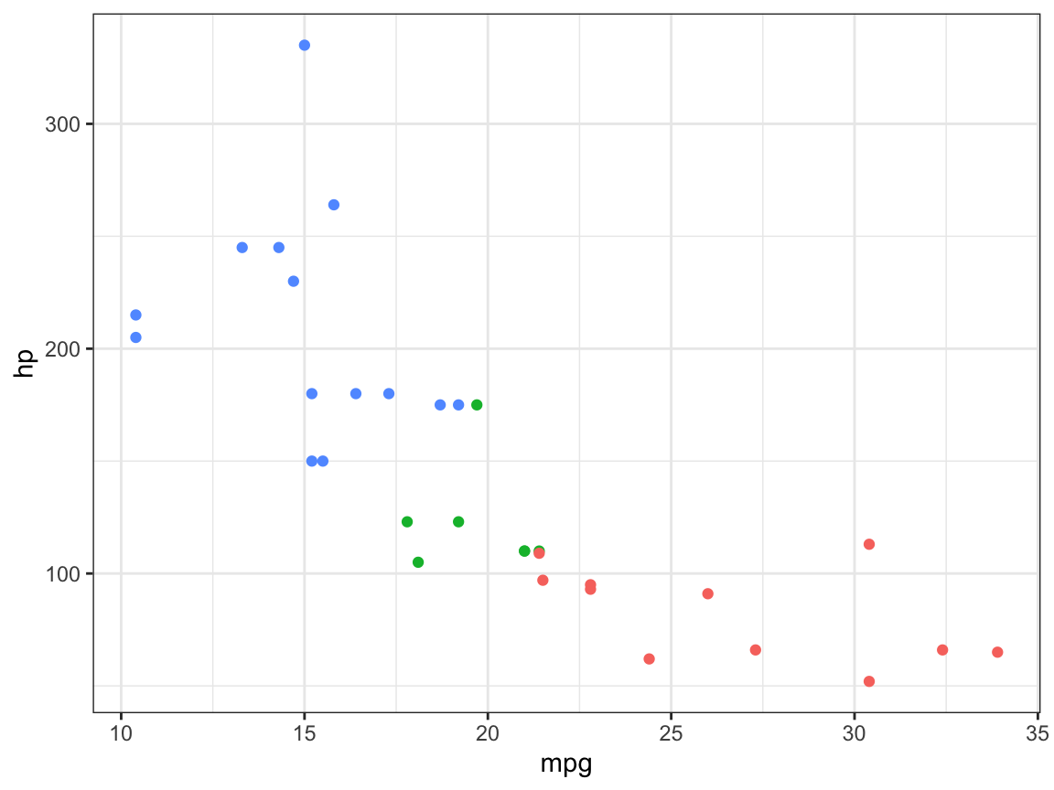
Legend Layout
We can change a lot about the layout of the figure legend, such as the legend.positon argument
Or no labels X
p <- ggplot(mtcars, aes(x = mpg,
y = hp)) +
geom_point(aes(color = factor(cyl)))
p + theme(legend.position = "right") # the default
p + theme(legend.position = "left")
p + theme(legend.position = "top")
p + theme(legend.position = "bottom")
p + theme(legend.position = "none") # no legend

Slide 41
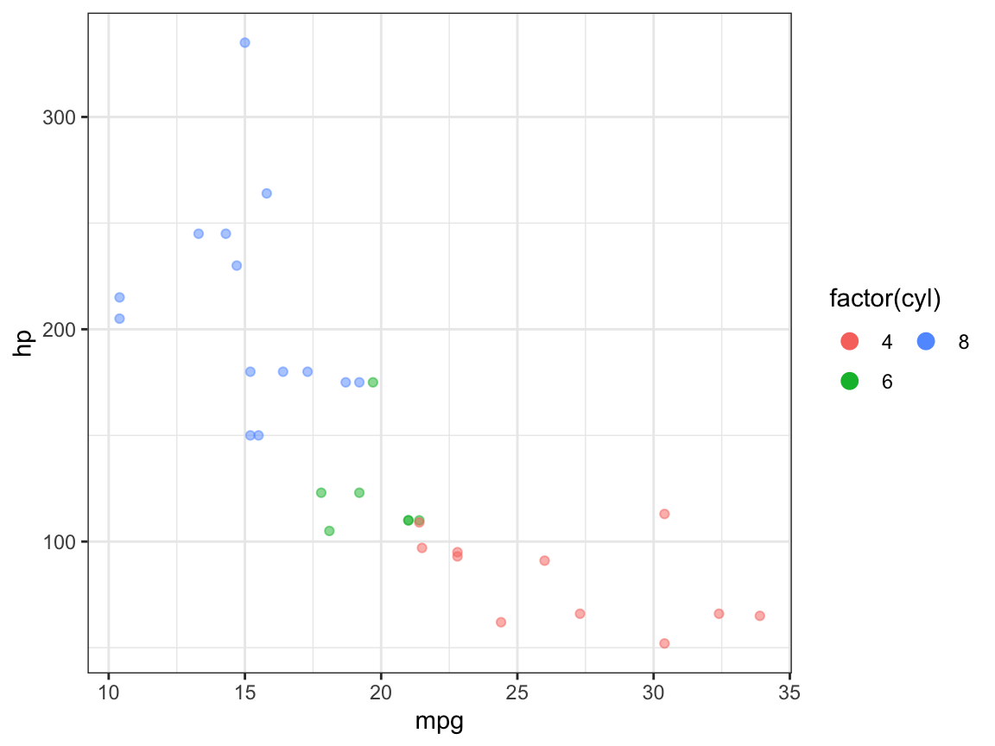
Legend Layout
We can use the guides() function to control the legend display
ggplot(mtcars, aes(x = mpg,
y = hp)) +
geom_point(aes(colour = factor(cyl)),
alpha = 0.5) +
guides(colour = guide_legend(ncol = 2,
override.aes =
list(size = 3, alpha = 1)))

Slide 42
Replacing the Colour Scale
The default ggplot2 colours we get are a bit rubbish
Many pre-defined colour palettes are available to change that
Such as from the RColorBrewer package:
https://www.r-graph-gallery.com/38-rcolorbrewers-palettes.html
ggplot(mtcars, aes(x = mpg,
y = hp)) +
geom_point(aes(color = factor(cyl))) +
scale_colour_brewer(palette = "Set1")

Slide 43
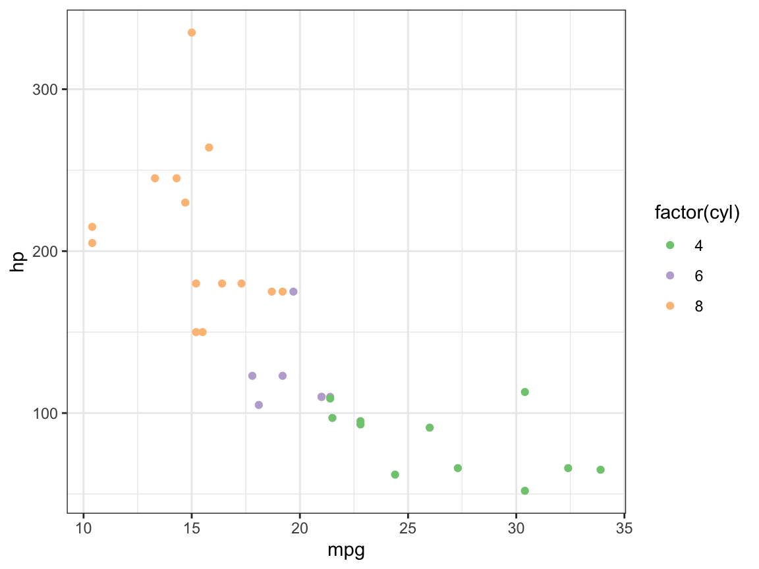

Replacing the Colour Scale
ggplot(mtcars, aes(x = mpg,
y = hp)) +
geom_point(aes(color = factor(cyl))) +
scale_colour_brewer(palette = "Accent")
Setting the colours manually
ggplot(mtcars, aes(x = mpg,
y = hp)) +
geom_point(aes(color = factor(cyl))) +
scale_colour_manual(values =
c("black", "pink", "turquoise"))

Slide 44

Replacing the Colour Scale
Setting the colours manually but for specific data groups
ggplot(mtcars, aes(x = mpg,
y = hp)) +
geom_point(aes(color = factor(cyl))) +
scale_colour_manual(values =
c(`4` = "black",
`6` = "pink",
`8` = "red"))

Slide 45
Saving a Plot
We of course want to be able to save the beautiful plots we make! We can do this using ggsave()
If not specified, it will save the most recent plot we create to our disk
The format of the plot is defined in the filename extension (.pdf or .png for example)
A good habit will be to work with R markdown files and save them to HTML outputs (like me and Frank!)
ggsave(filename = "my_plot_1.pdf")
ggsave(filename = "my_plot_2.png")

Slide 46

Boxplots and Violin Plots
Boxplots and Violin Plots are very common within biolosciences (protein levels, patient data, SNP frequency etc.)
Have a go at creating your own boxplots and violin plots using the mtcars/diamonds/other datasets!
mtcars$cyl <- as.factor(mtcars$cyl)
p <- ggplot(mtcars, aes(cyl, mpg))
p + geom_boxplot(aes(colour = cyl))

Slide 47




Boxplots and Violin Plots
p + geom_boxplot(aes(fill = cyl), alpha = 0.3) +
geom_point()
p + geom_violin(aes(colour = cyl))
p + geom_violin(aes(fill = cyl))
p + geom_violin(aes(fill = cyl)) + geom_point()

Slide 48



Boxplots and Violin Plots
ggplot(data = diamonds,
mapping = aes(x = color,
y = price)) +
geom_boxplot(outlier.size = -1)
# discretise numeric data into categorical ggplot(diamonds, aes(x = carat,
y = price)) +
geom_boxplot(aes(group = cut_width(carat, 0.2)))
ggplot(diamonds, aes(x = carat,
y = price)) +
geom_boxplot(aes(group = cut_number(carat, 20)))

Slide 49

3D Plots
Plotly is a great package for creating interactive 3D plots for web graphics
# install.packages("plotly")
library(plotly)
mtcars$gear <- as.factor(mtcars$gear)
plot_ly(mtcars, x = ~wt,
y = ~hp,
z = ~qsec,
color = ~gear) %>%
add_markers() %>%
layout(scene = list(
xaxis = list(
title = 'Weight’),
yaxis = list(
title = 'Gross horsepower’),
zaxis = list(
title = '1/4 mile time')))

Slide 50

3D Plots
You can even create a volcano!
# volcano is a numeric matrix that ships with R
plot_ly(z = ~volcano) %>%
add_surface()

Slide 51
Some Useful Links and Resources
Will you remember all of this? Almost certainly not!
We’re bioinformaticians, use the cheat sheets!
ggplot2 cheat sheet available from: http://rstudio.com/resources/cheatsheets
https://ggplot2-book.org
https://exts.ggplot2.tidyverse.org/gallery/
https://www.r-graph-gallery.com
https://github.com/jrnold/ggthemes

Slide 52
Visualisation in
Sam Keat
PhD Student - UK Dementia Research Institute, Cardiff
KeatS@cardiff.ac.uk

